Slide 1

Data analysis report
Jiyang Chen(A20490982)
Yang Li(A20478590)
Mingyuan Wang(A20501460)
Let’s Start

Slide 2
Introduce
WORK REPORT
Data cleaning
WORK REPORT
Contents
Data integration
WORK REPORT
Data extraction
WORK REPORT

Slide 3
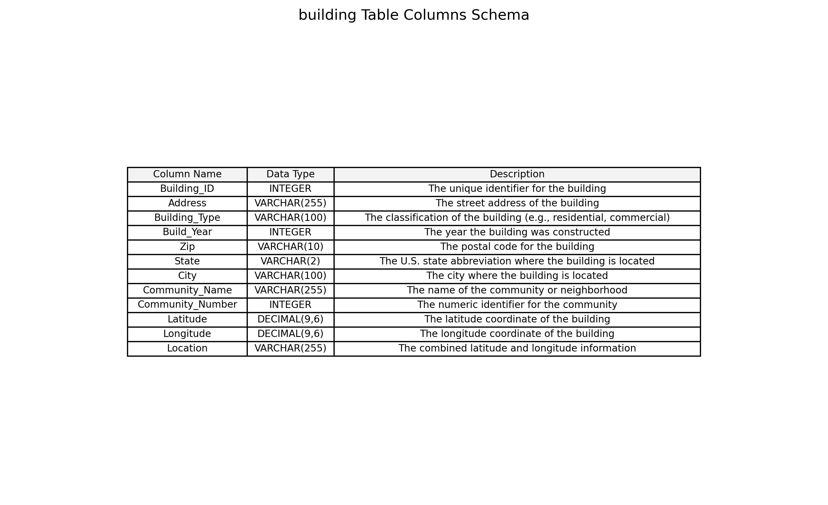

Slide 4
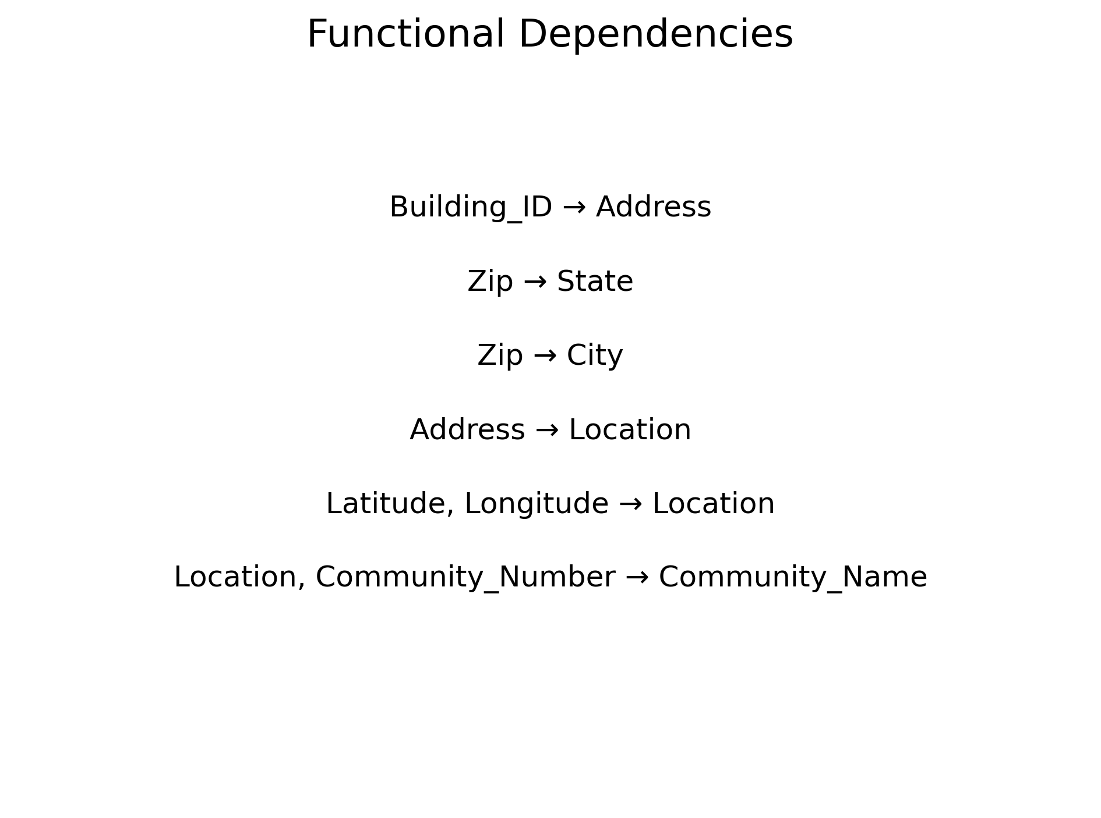
The following constraints have been defifined for the dataset:

Slide 5
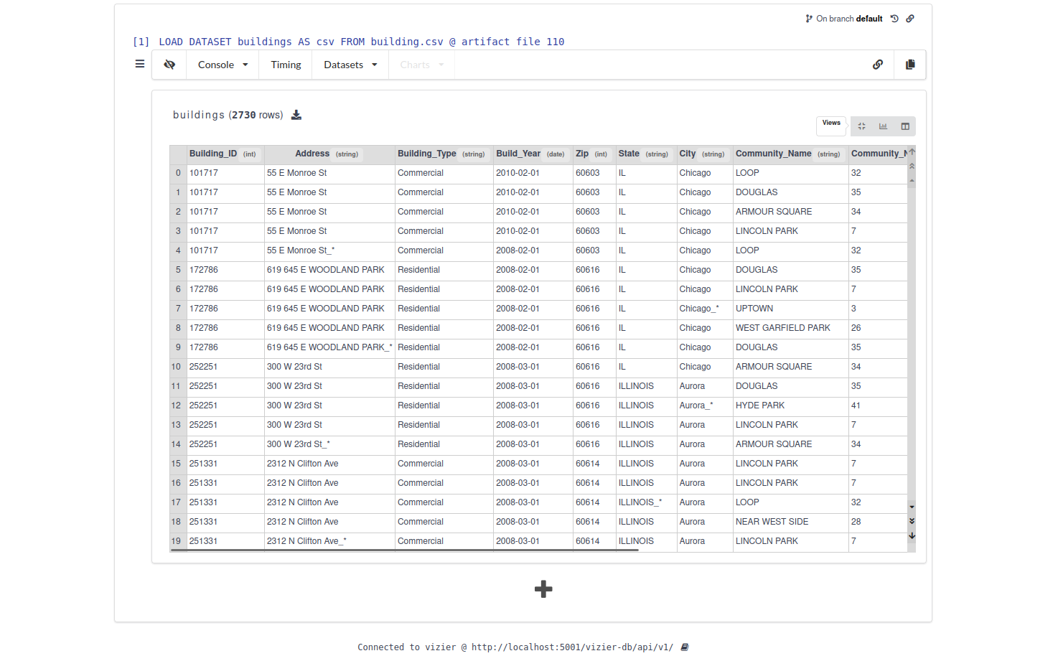
Data import into VizierDB:

Slide 6
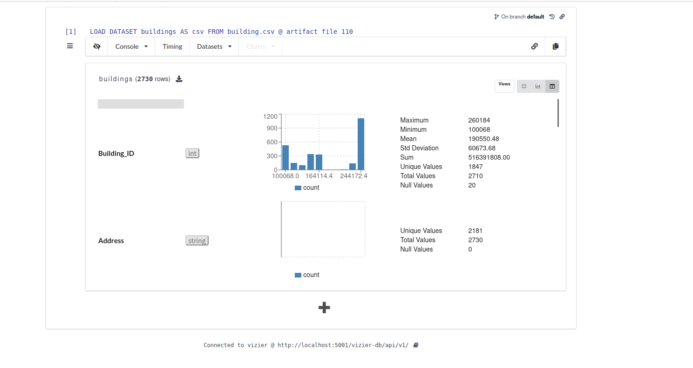
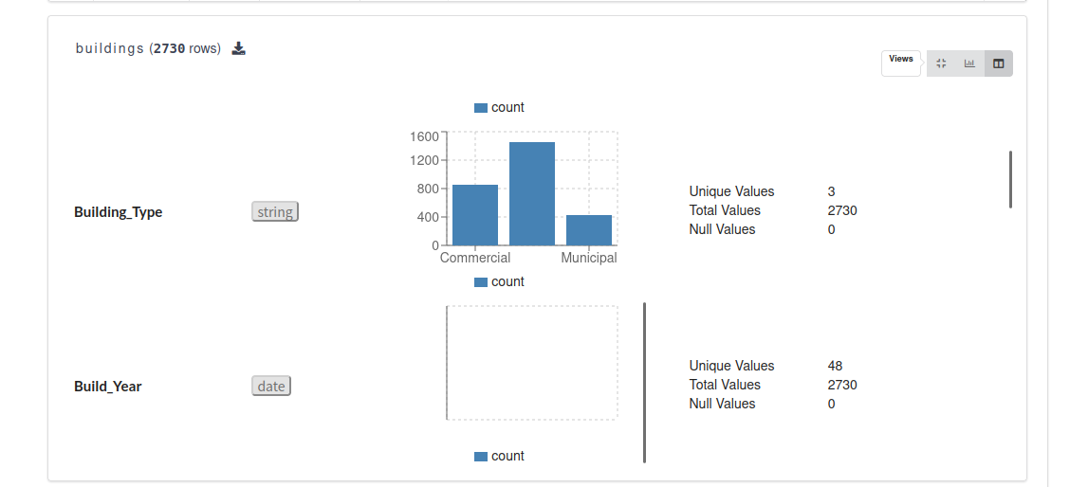
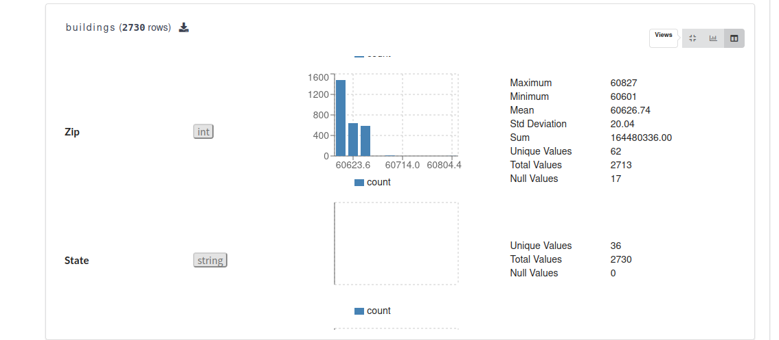
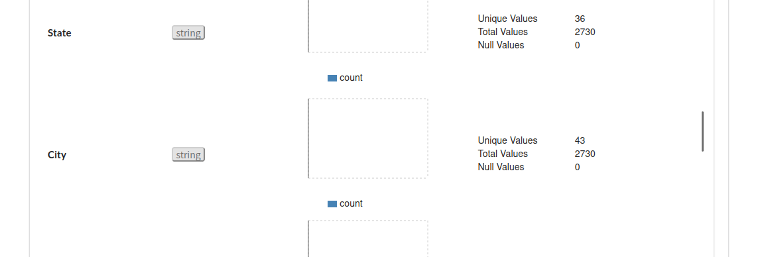
Viewing individual column information,You can see a lot of nulls and duplicates by the information in the columns:

Slide 7
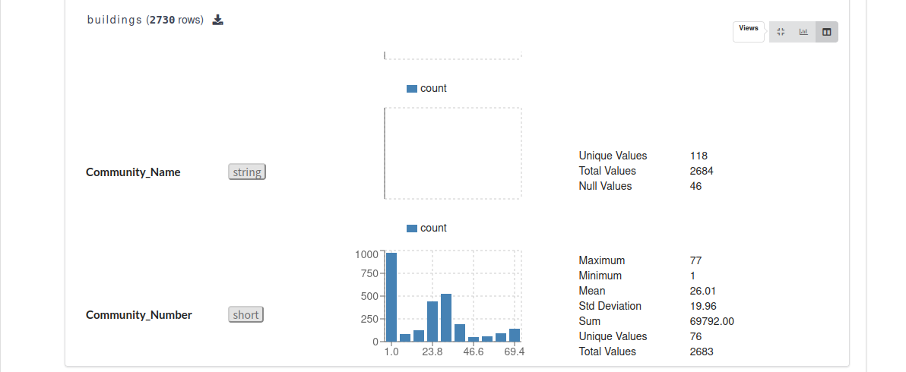
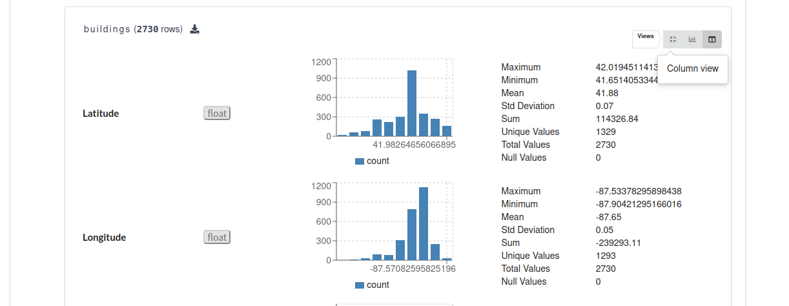
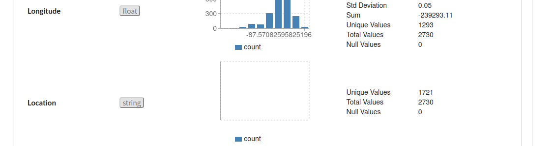

Slide 8
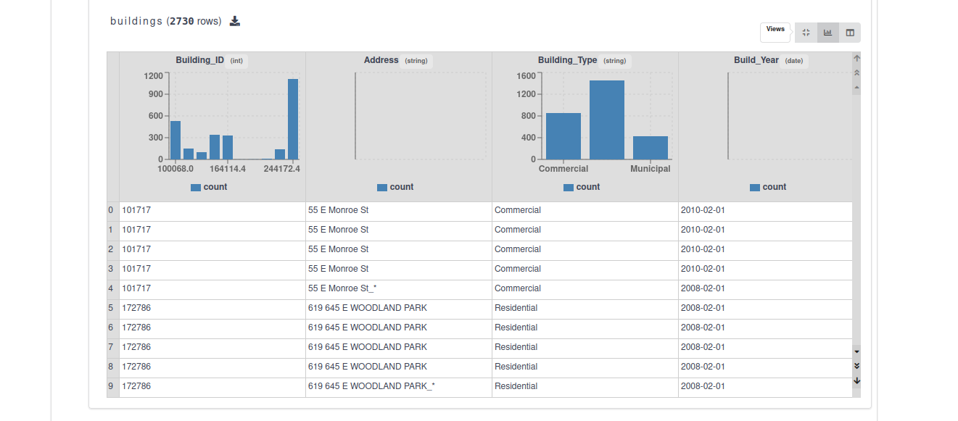
Viewing the distribution of column values:

Slide 9
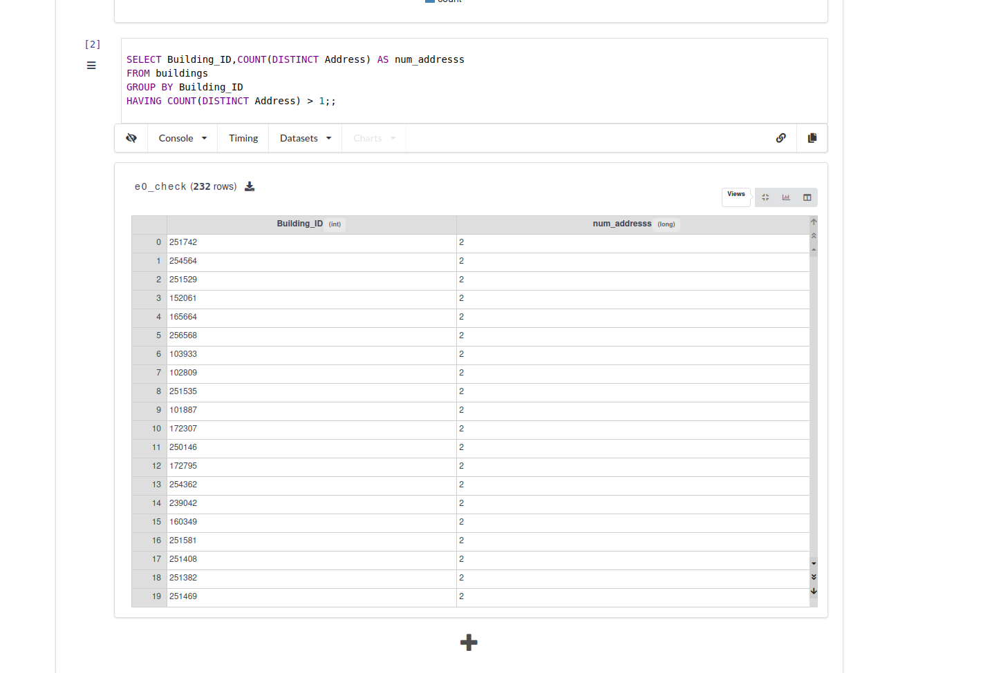
Detecting Constraint Violations:

Slide 10
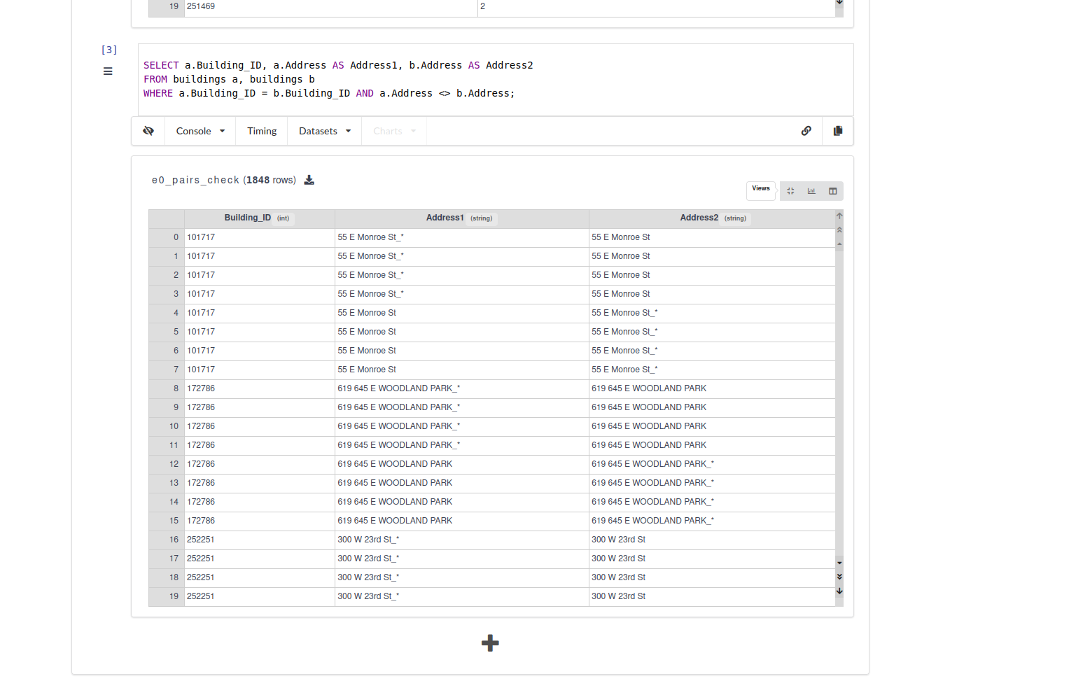

Slide 11
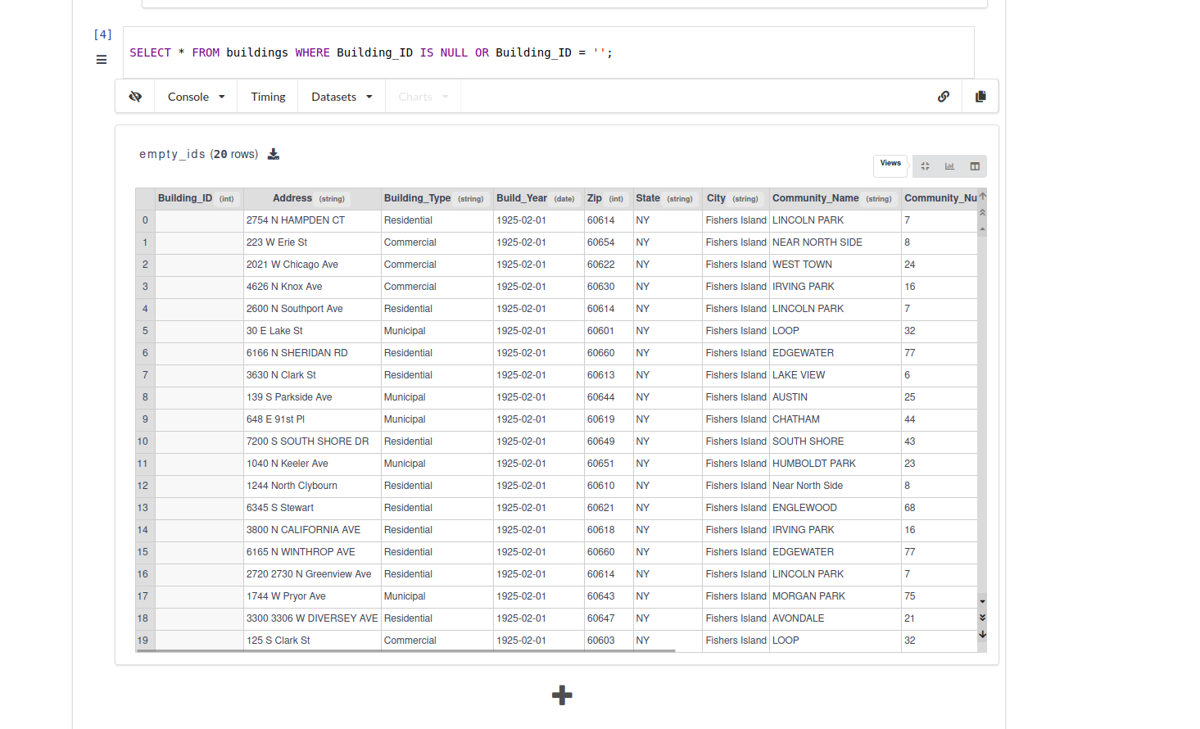
Data cleaning
Checking for data with a null ID:

Slide 12
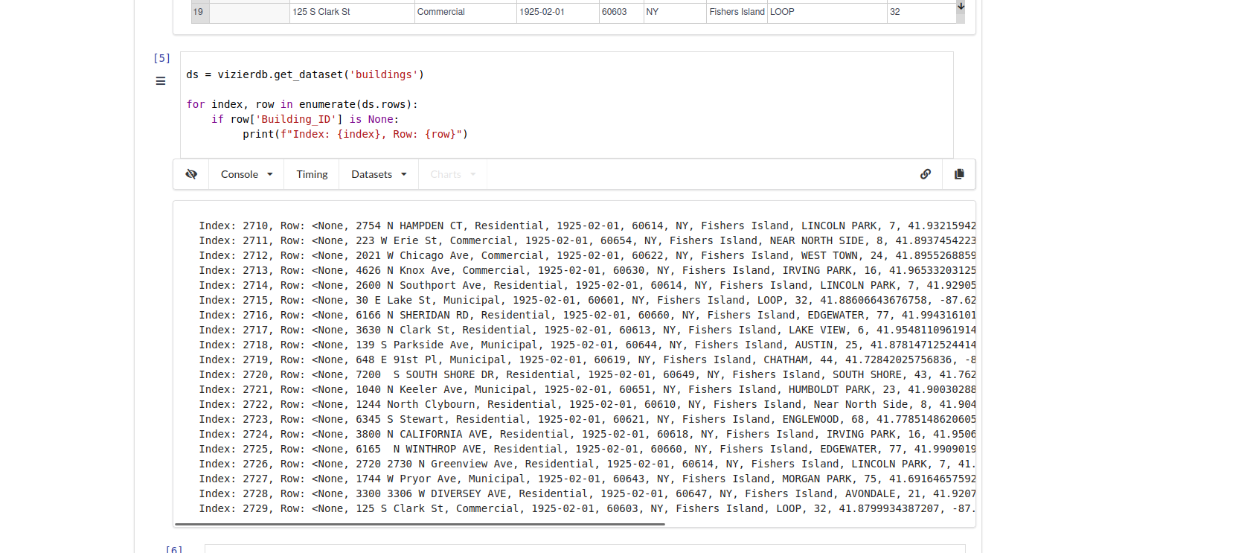
Data cleaning

Slide 13
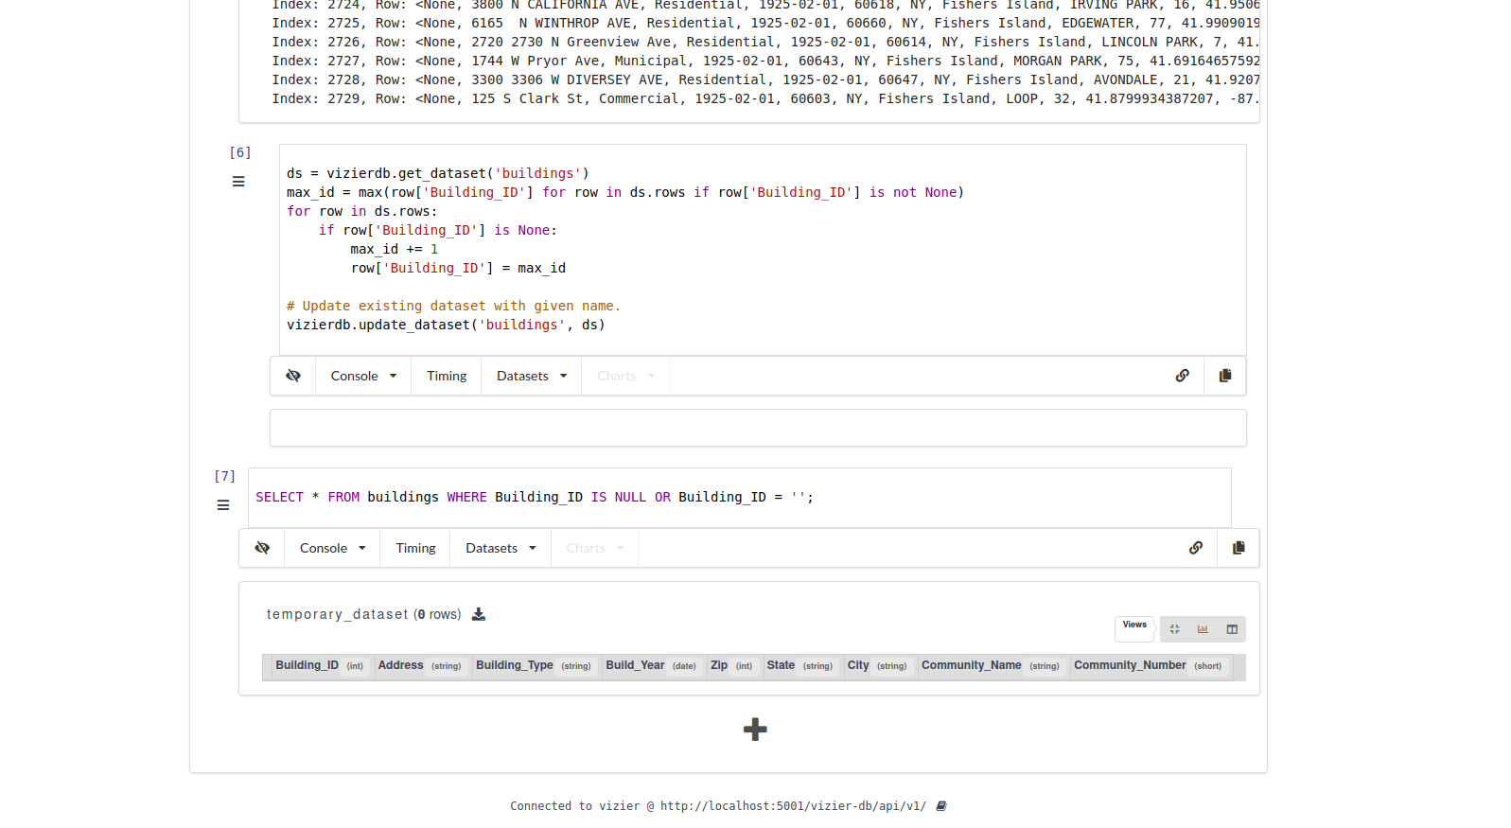
Data cleaning
fixes data with empty ID, fix ID to the maximum ID value plus 1.

Slide 14
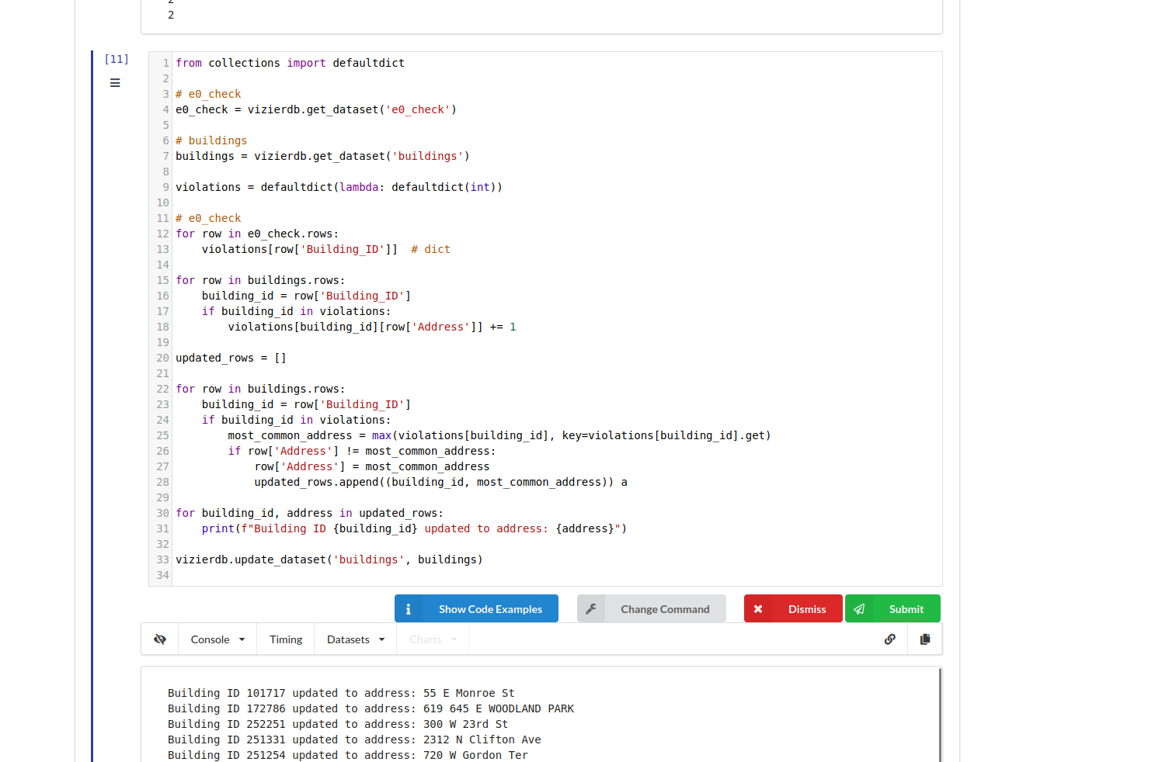
Data cleaning
Now start fixing the e0 constraint data: the program uses "Update Equivalent Right Side" to fix the violation, using the frequency of each class this strategy: select the value with the highest number of occurrences in each of the right hand side attributes of the equivalence class, and select the value with the highest number of occurrences of Addresses under the Building_ID category Update

Slide 15
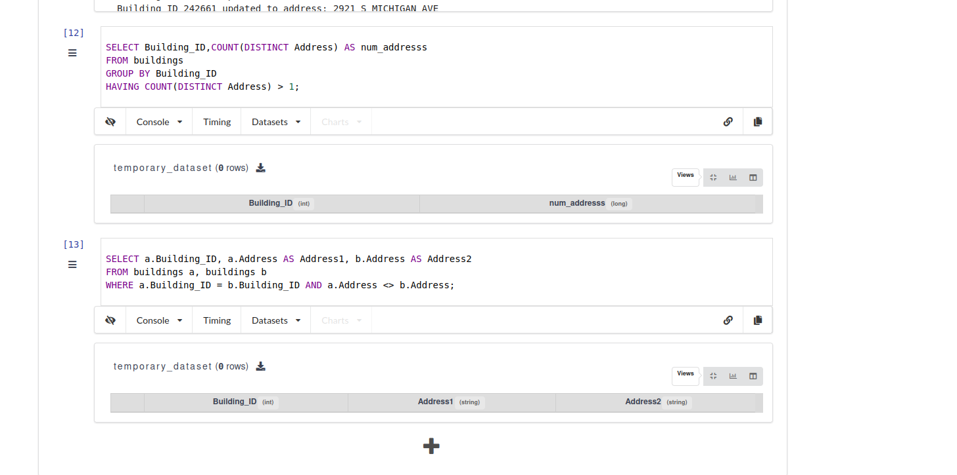
Data cleaning
Checking after fixing,The e0 constraint data has been successfully fixed:

Slide 16
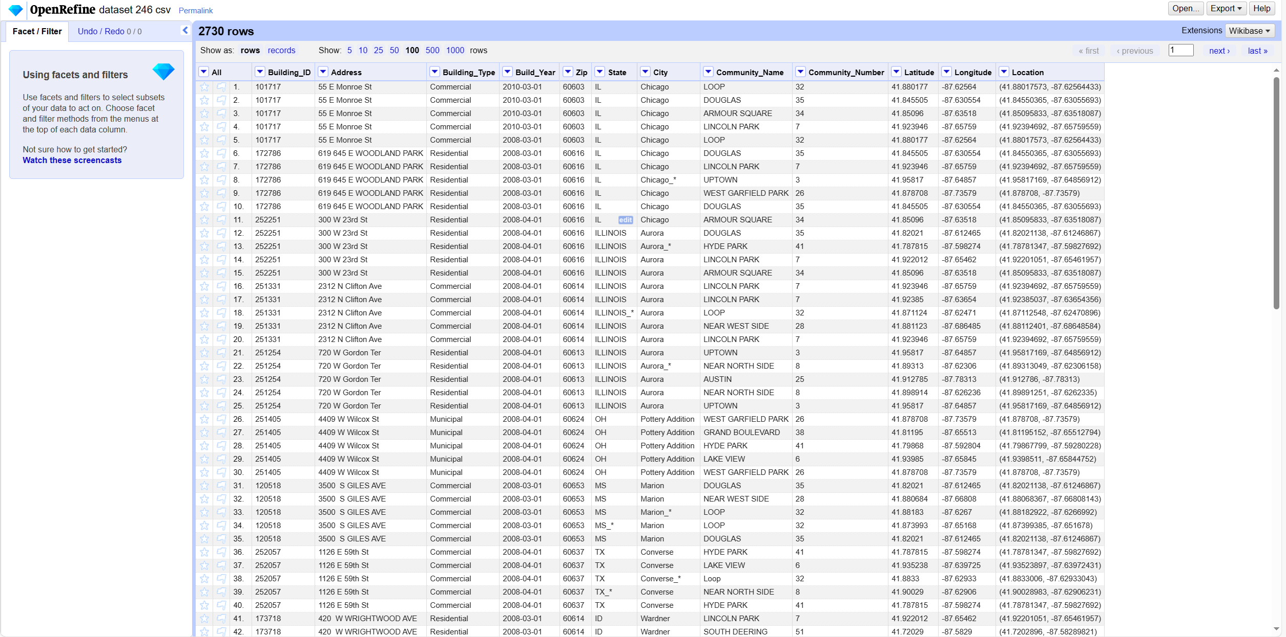
Data cleaning
Export the fixed data and import the exported data into openRefine:

Slide 17
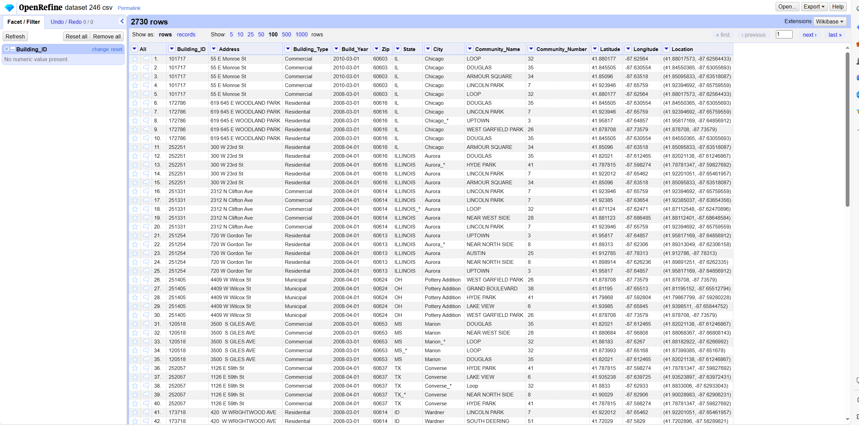
Data cleaning
View Number facet under Building_ID column,Check for non-numeric,You can see that there are no non-numeric:

Slide 18
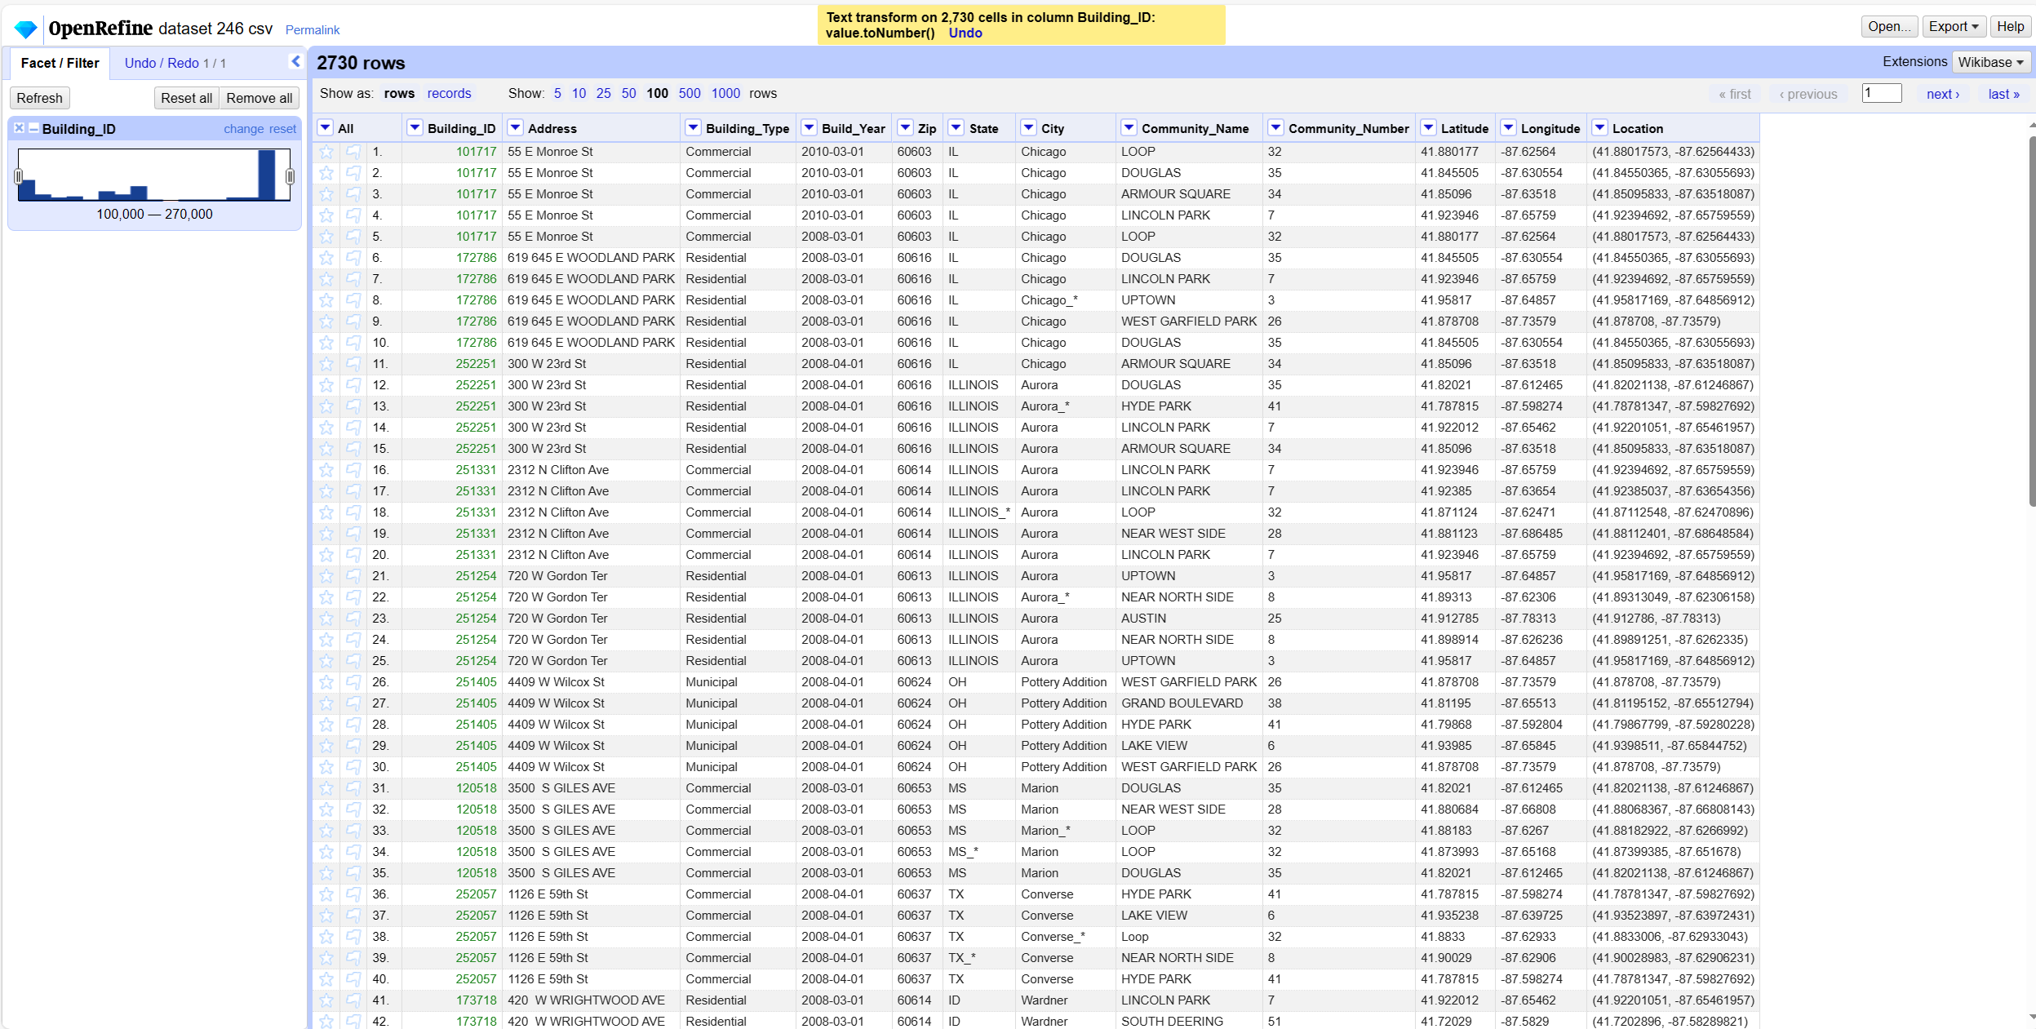
Data cleaning
Convert all values under the Build_ID column to numeric types: use Commons transforms To Number,You can see that all are converted to numeric types with no null or other values

Slide 19
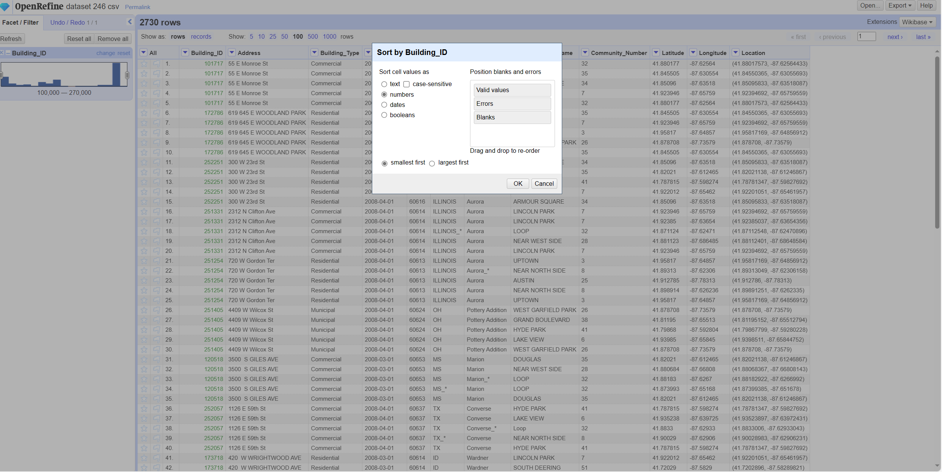
Data cleaning
Permanently sort the Build_ID column by number

Slide 20
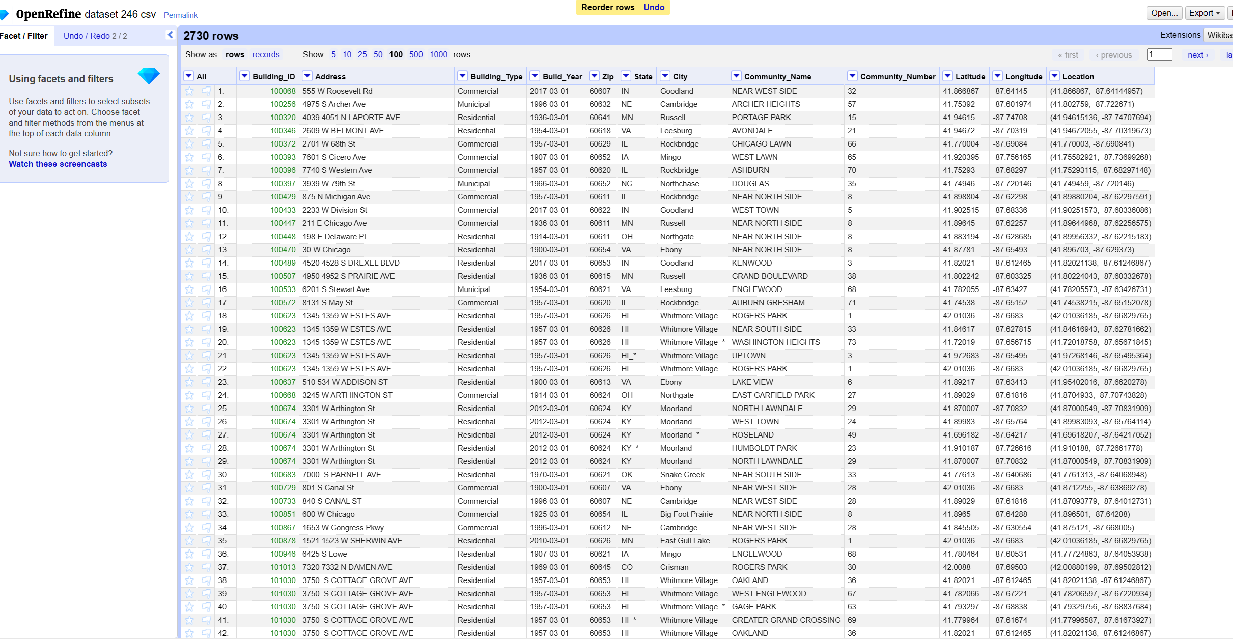
Data cleaning
Data after permanent sorting

Slide 21
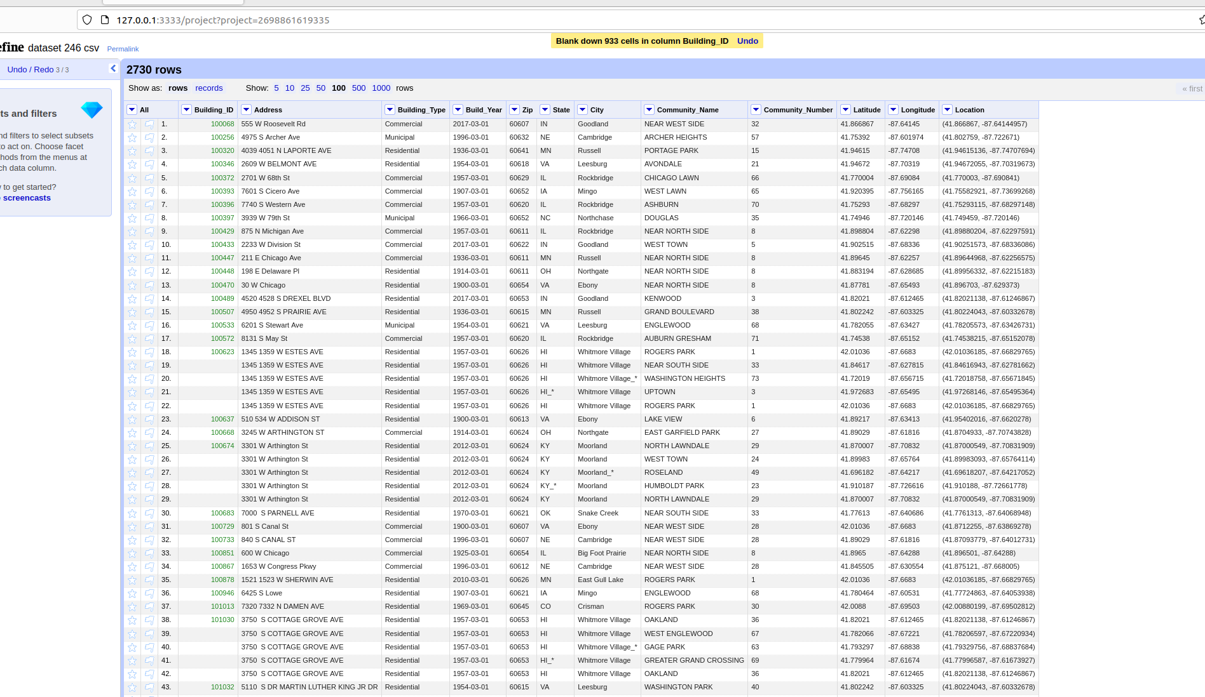
Data cleaning
Build_ID column values are checked for duplicates adjacent to each other using Blank down

Slide 22
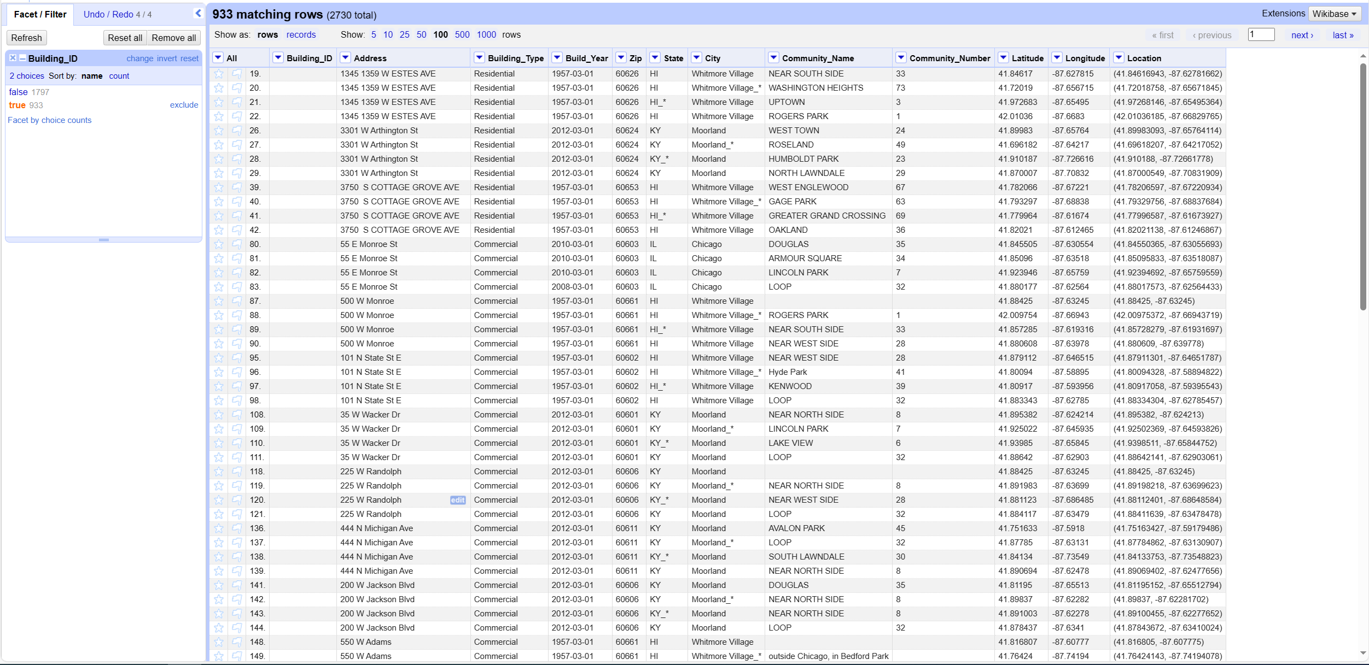
Data cleaning
To detect if a Build_ID column value has a null character, use Facet by blank

Slide 23
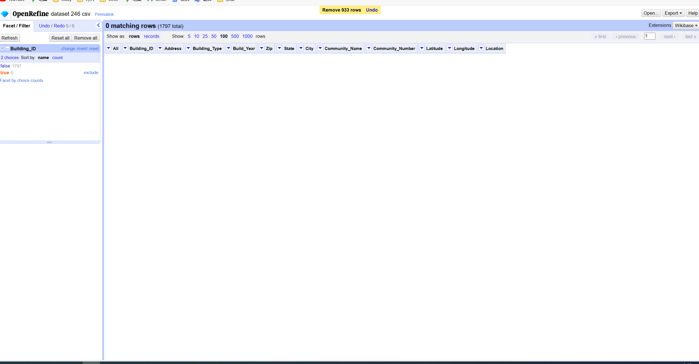
Data cleaning
You can see that there are 933 data Build_ID characters are empty, delete the empty Build_ID.

Slide 24
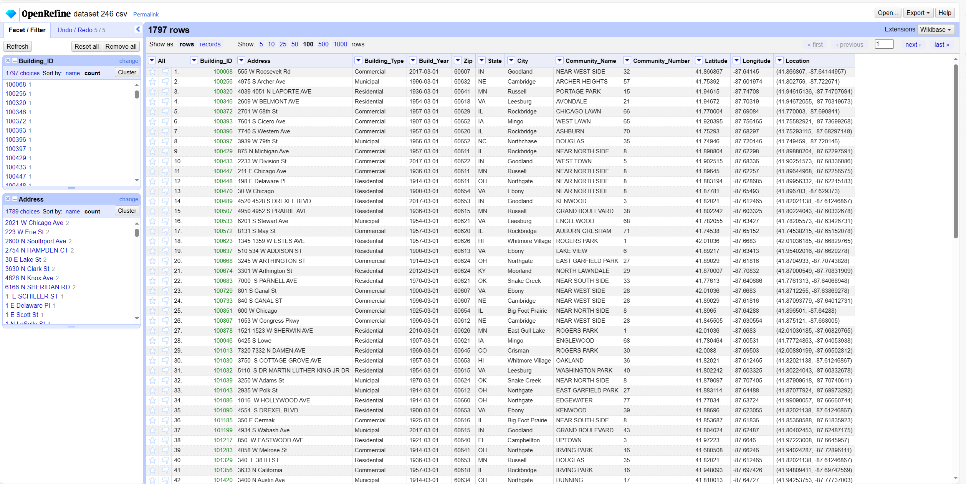
Data cleaning
Checking the e0 constraints again, you can see that they are all satisfied.

Slide 25
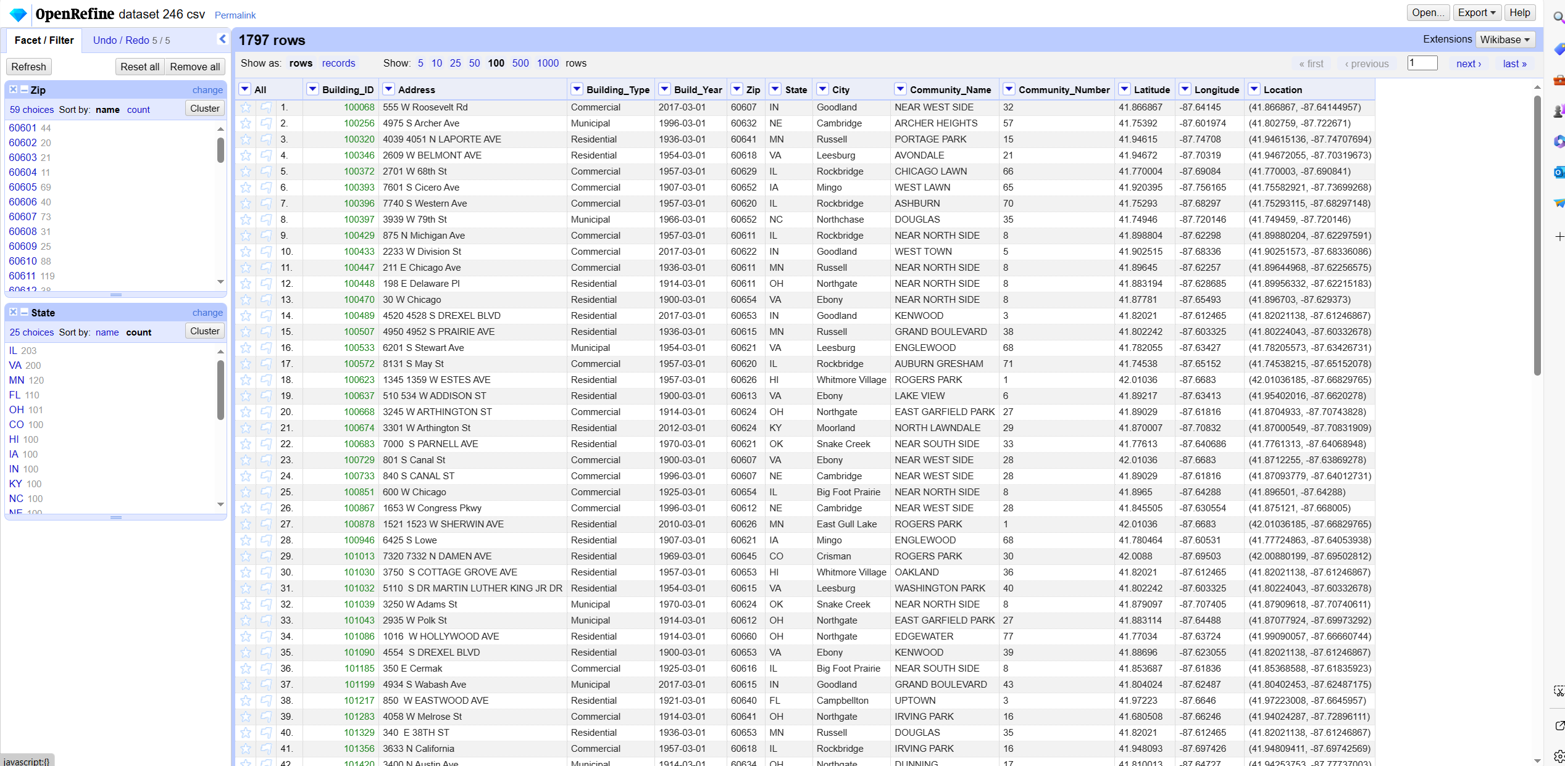
Data cleaning
Start detecting the e1 constraint:Zip →State
First look at the State column value distribution

Slide 26
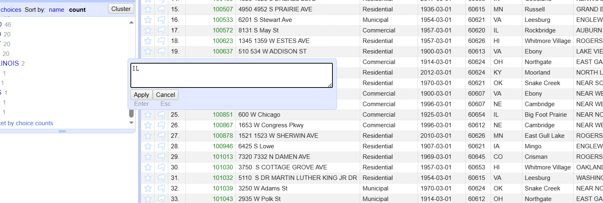
Data cleaning
In order to standardise the State nomenclature, change the non-uniform nomenclature ILLINOIS to IL.

Slide 27
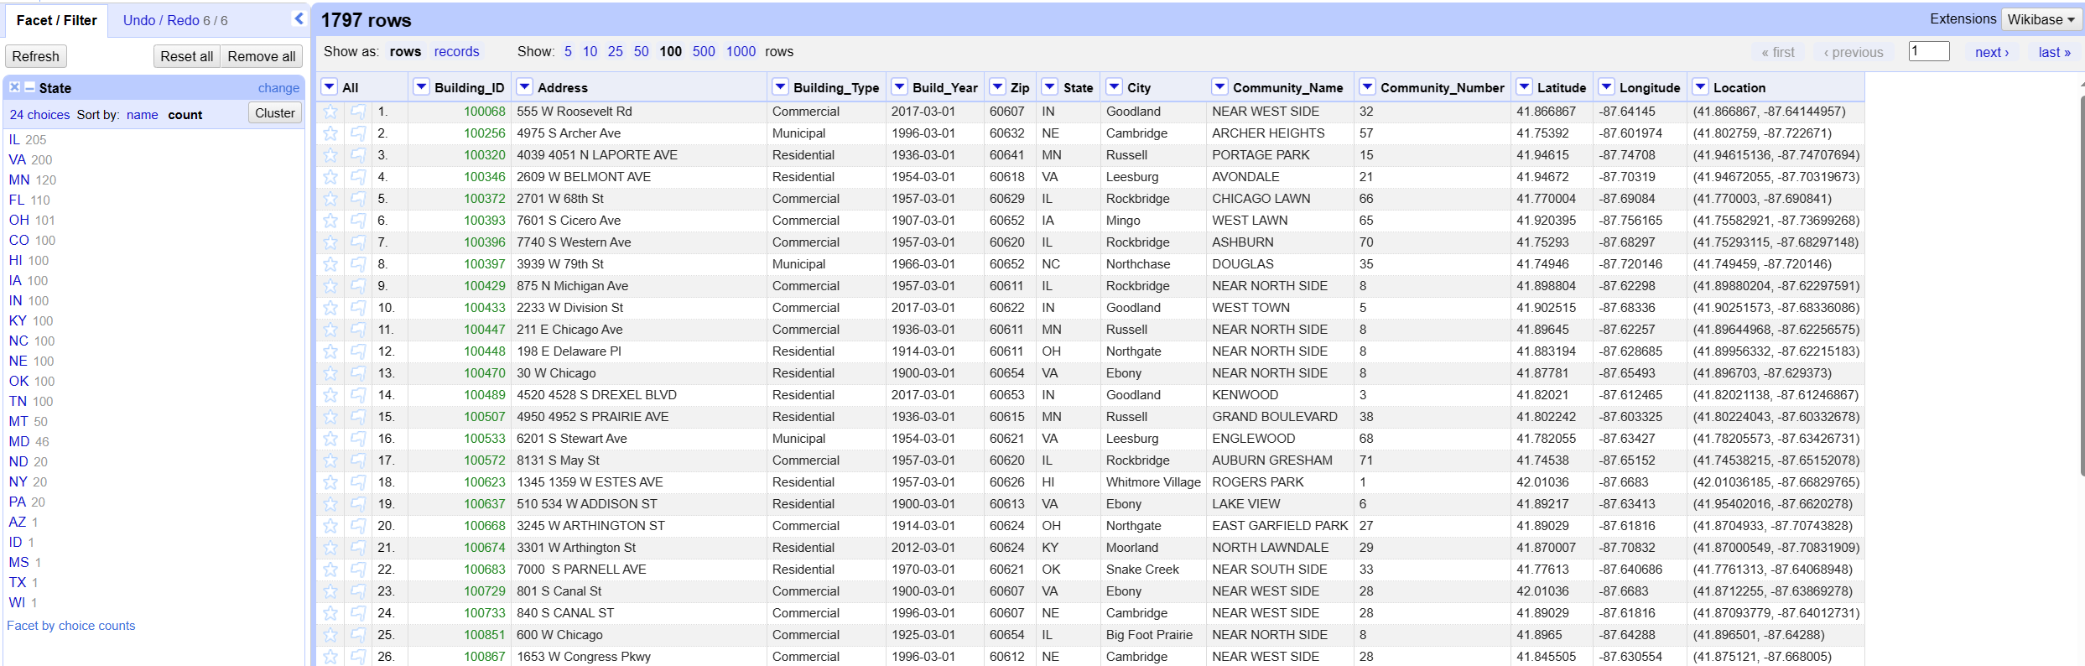
Data cleaning
View the distribution of State column values after modification:

Slide 28
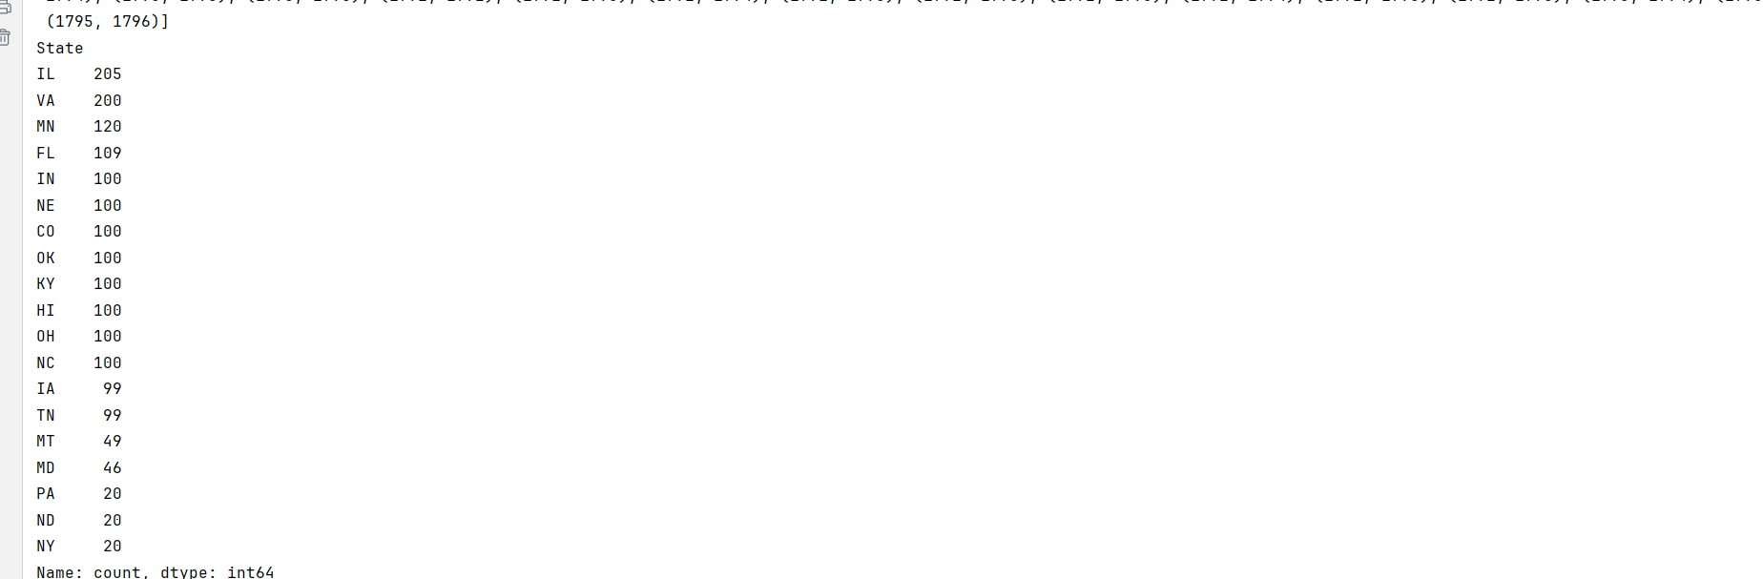
Data cleaning
Because State update and Zip, City columns are associated, taking into account the cost of updating, in order to State find duplicate matches, we use distance measure, select threshold β = 5, using Python distance measure state column distribution and the distribution of the above columns is the same, proving that our threshold β is the correct choice, will be merged to match the merged data to be re-saved:

Slide 29
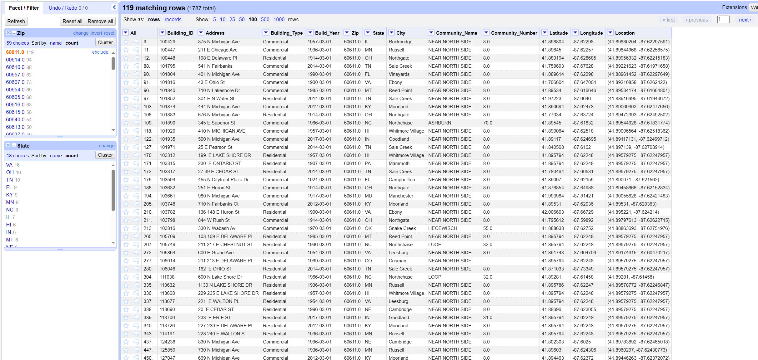
Data cleaning
Import the re-saved data into openRefine and then revisit the distribution of State values corresponding to each Zip:

Slide 30
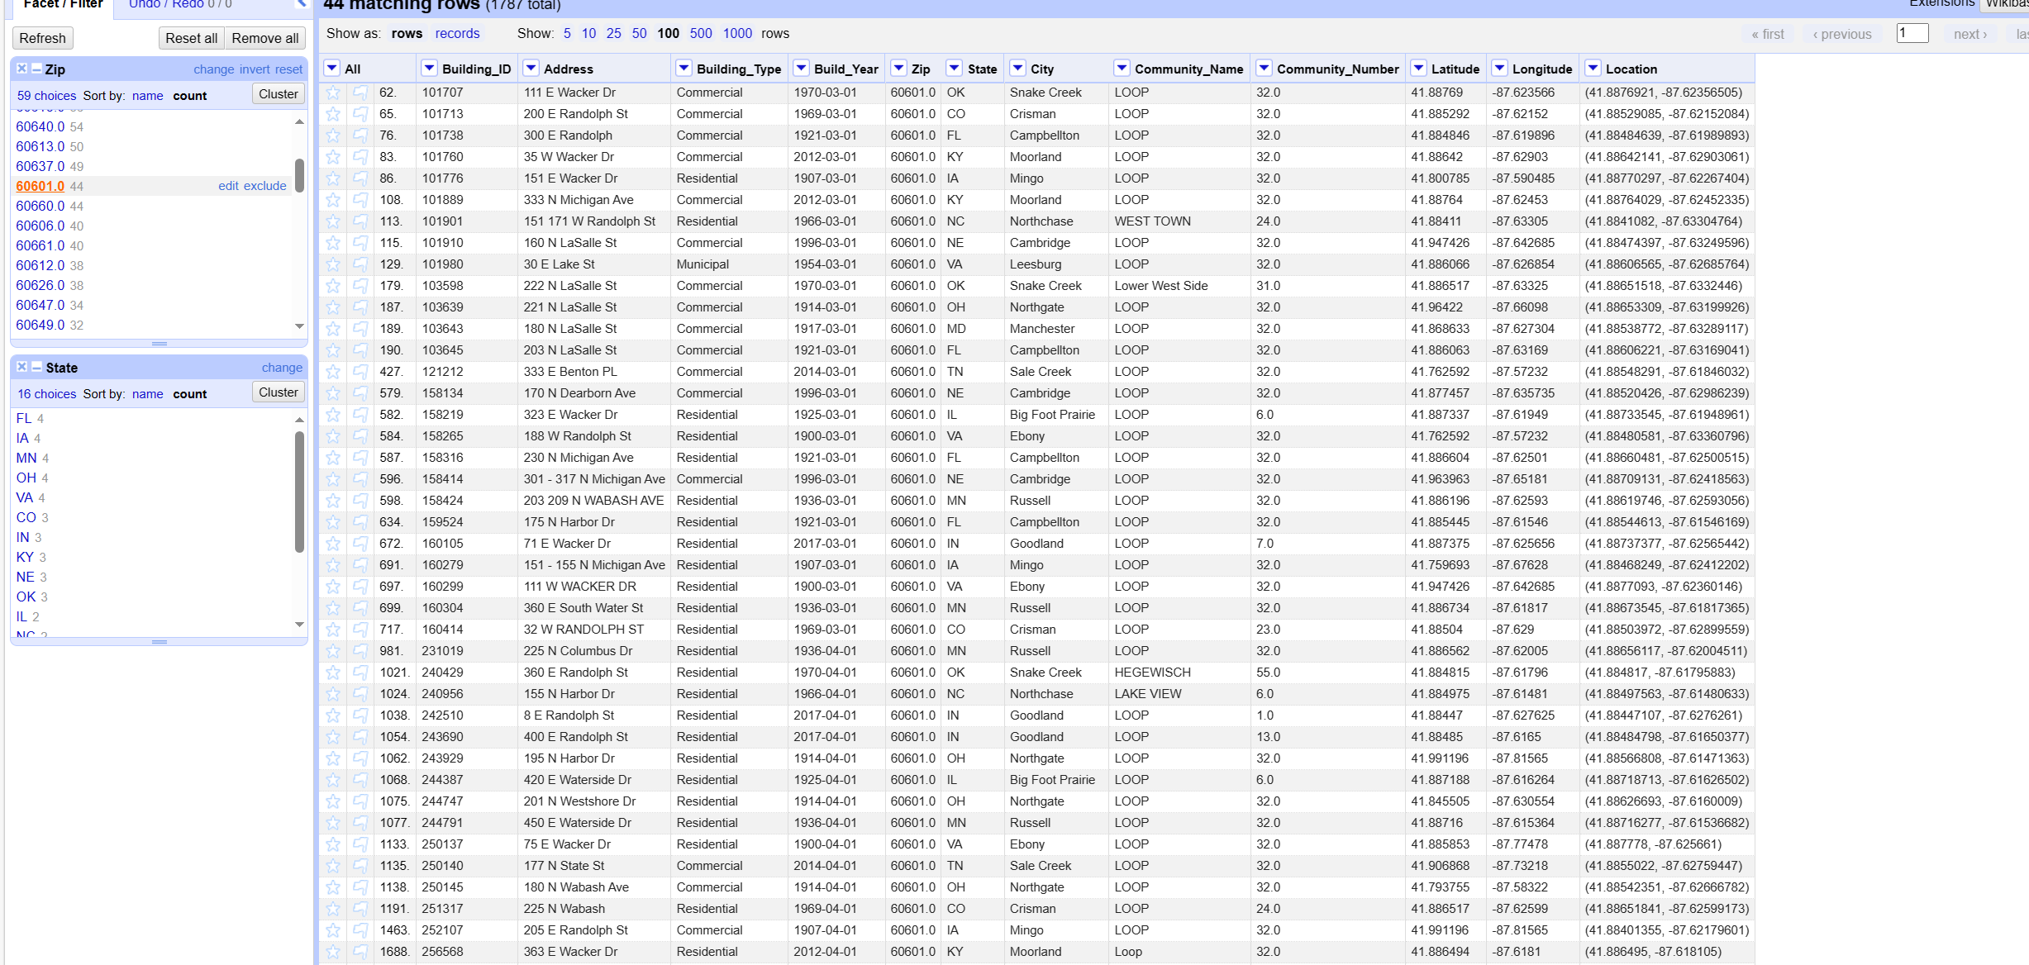
Data cleaning

Slide 31
Data cleaning
You can see that although the use of distance measure to remove some of the duplicate data, but still can not meet the e1 constraints, in order to meet the e1 constraints, we select the Zip under the State most frequent values, will be under the State class value update to the most frequent values, for the most frequent value of the same value for more than one State value, the use of weight algorithms, the weight based on the State column, the frequency of the appearance of State divided by the total number of values in the column of the State calculation, the City columns are also used in the same way to fix the repair, the use of Python merge repair, the completion of the repair, reread after importing the OpenRefine:

Slide 32
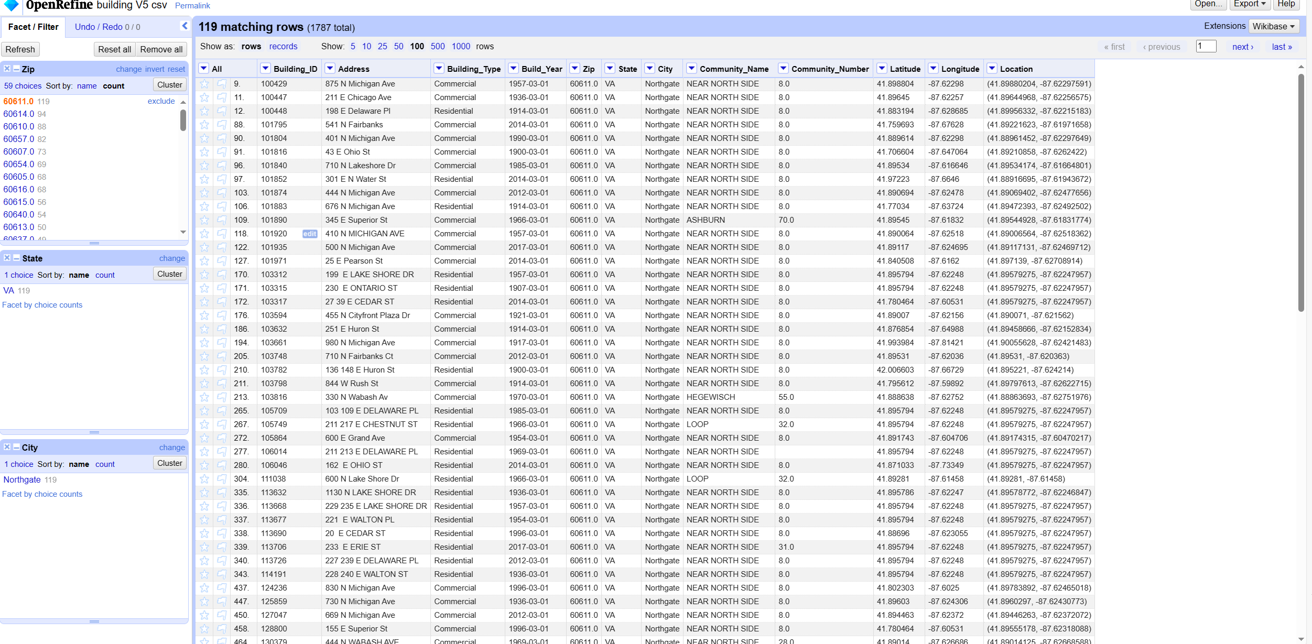
Data cleaning
Distribution of Zip,State,City columns after fixing:

Slide 33
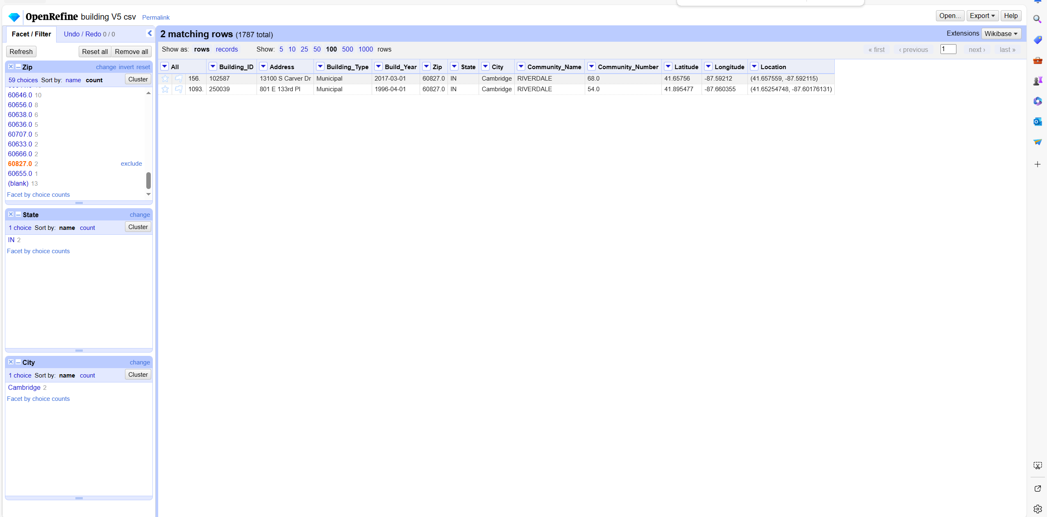
Data cleaning
Distribution of Zip,State,City columns after fixing:

Slide 34
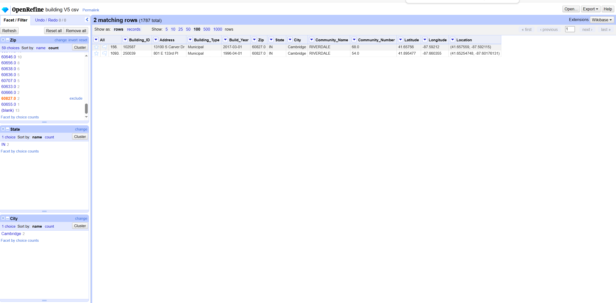
Data cleaning
Distribution of Zip,State,City columns after fixing,You can see that e2,e3 have now satisfied the constraints:

Slide 35
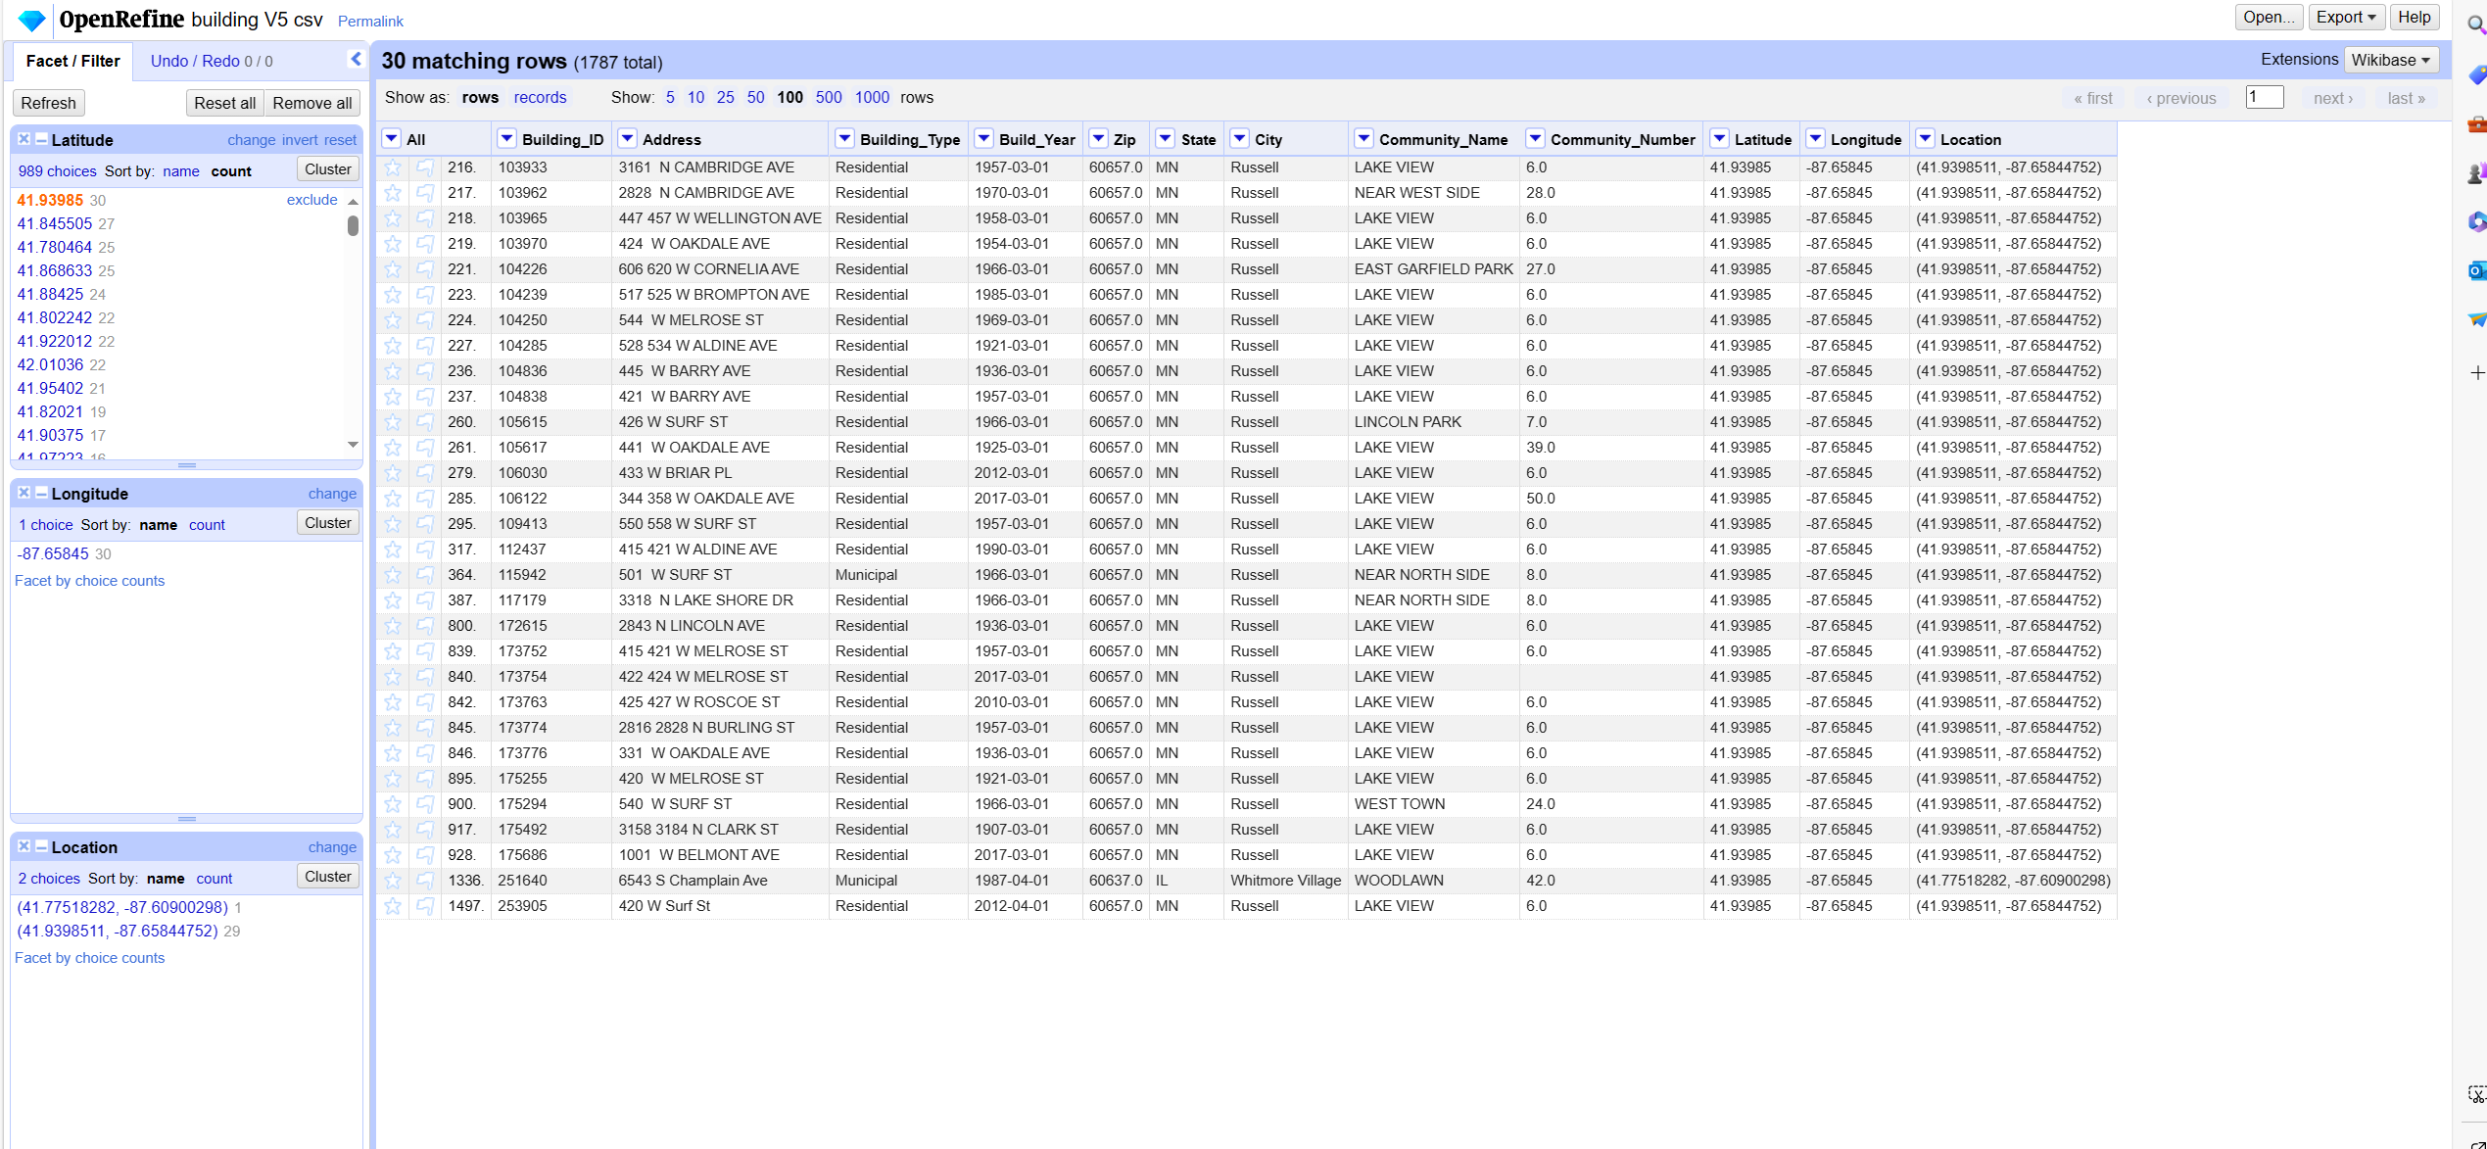
Data cleaning
Now start fixing e4, first check the distribution of e4 constraint columns:

Slide 36
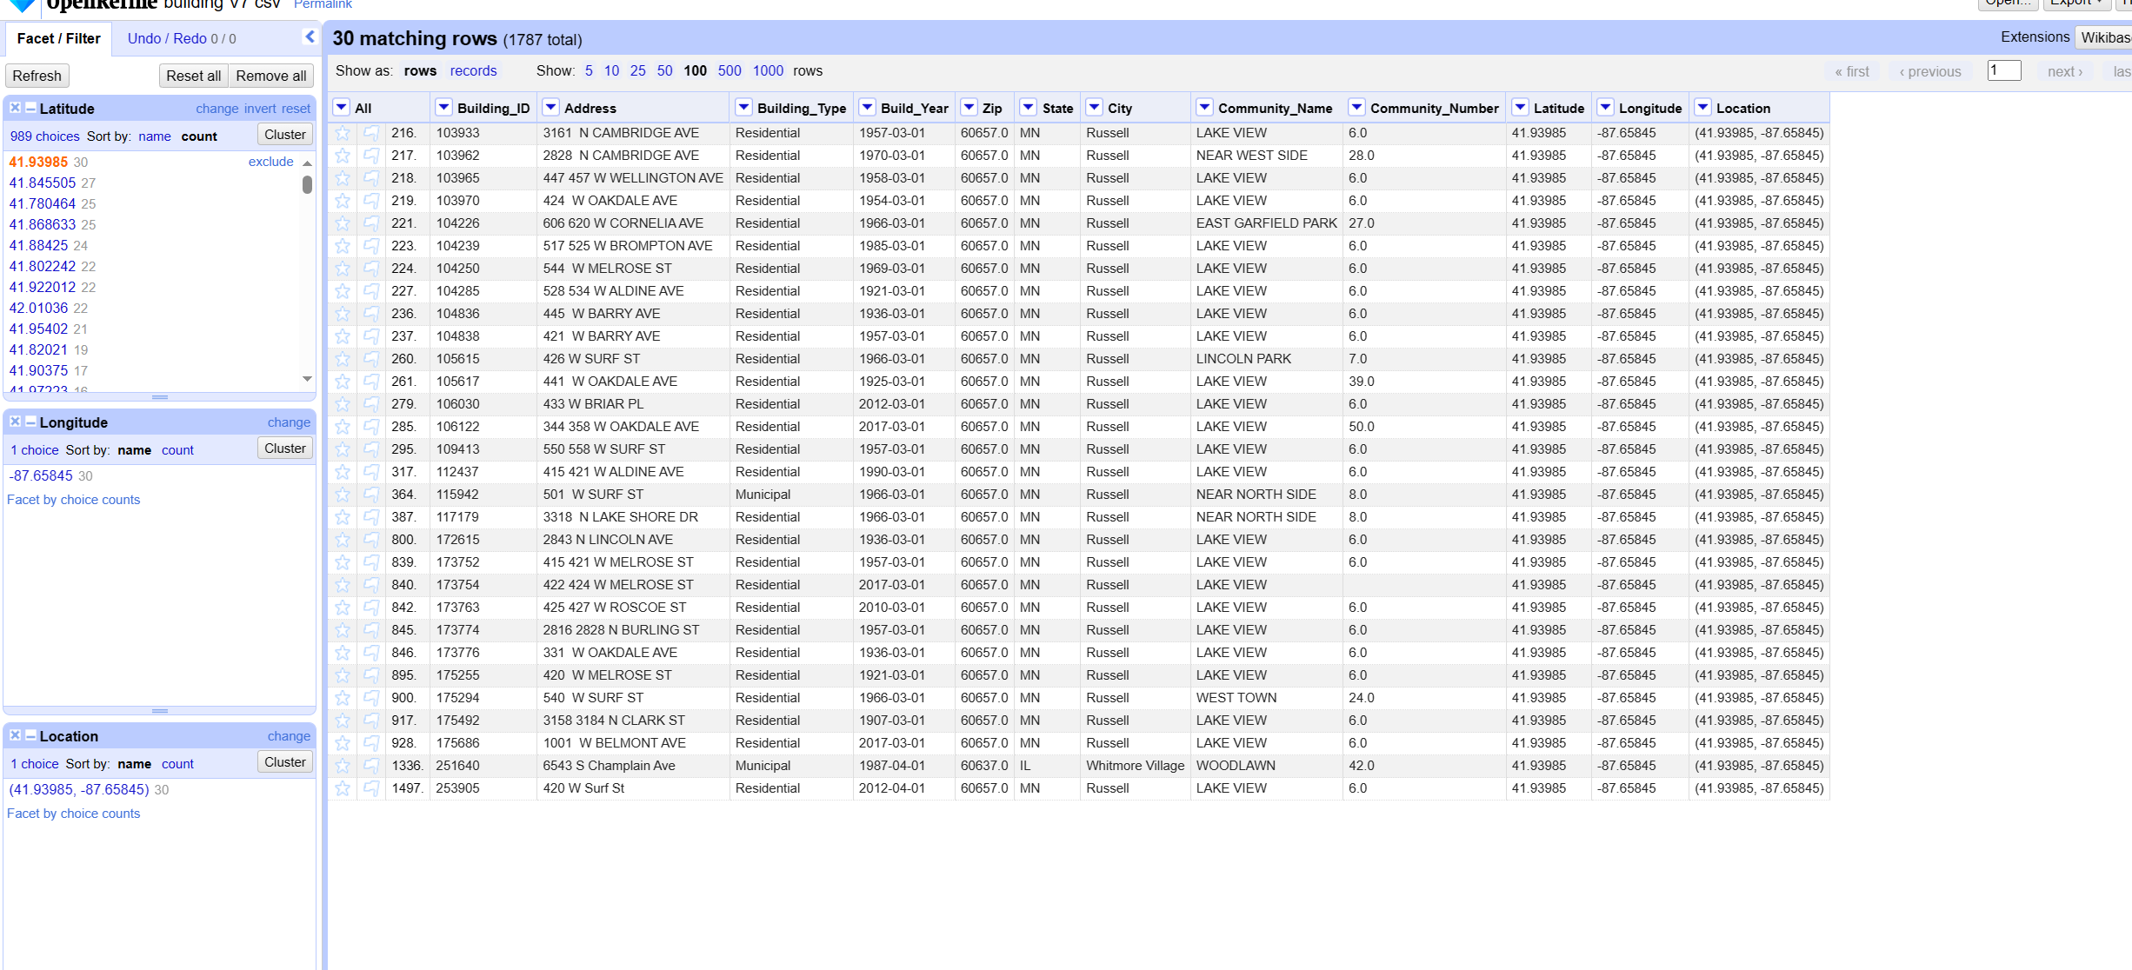
Data cleaning
In order to meet the e4 constraints, we choose Latitude, Longitude under the Location of the most frequent values, will be updated to the most frequent values under the Location category, for the most frequent values are equal to the value of multiple Locations, the default direct return to the first to find the maximum value of the use of Python merge fix, merge all the Locations will be set to a combination of Latitude and Longitude after the completion of the fix to re-import the OpenRefine

Slide 37
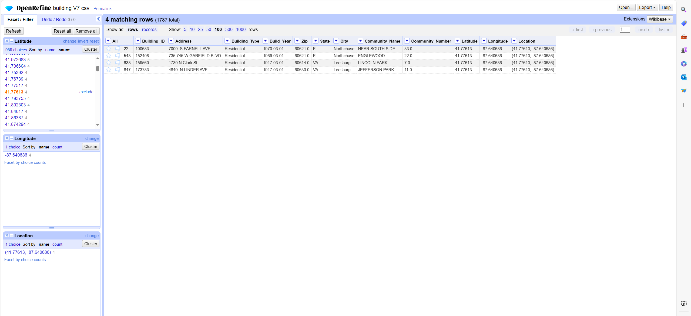
Data cleaning
Detect column value distribution after fixing e4:

Slide 38
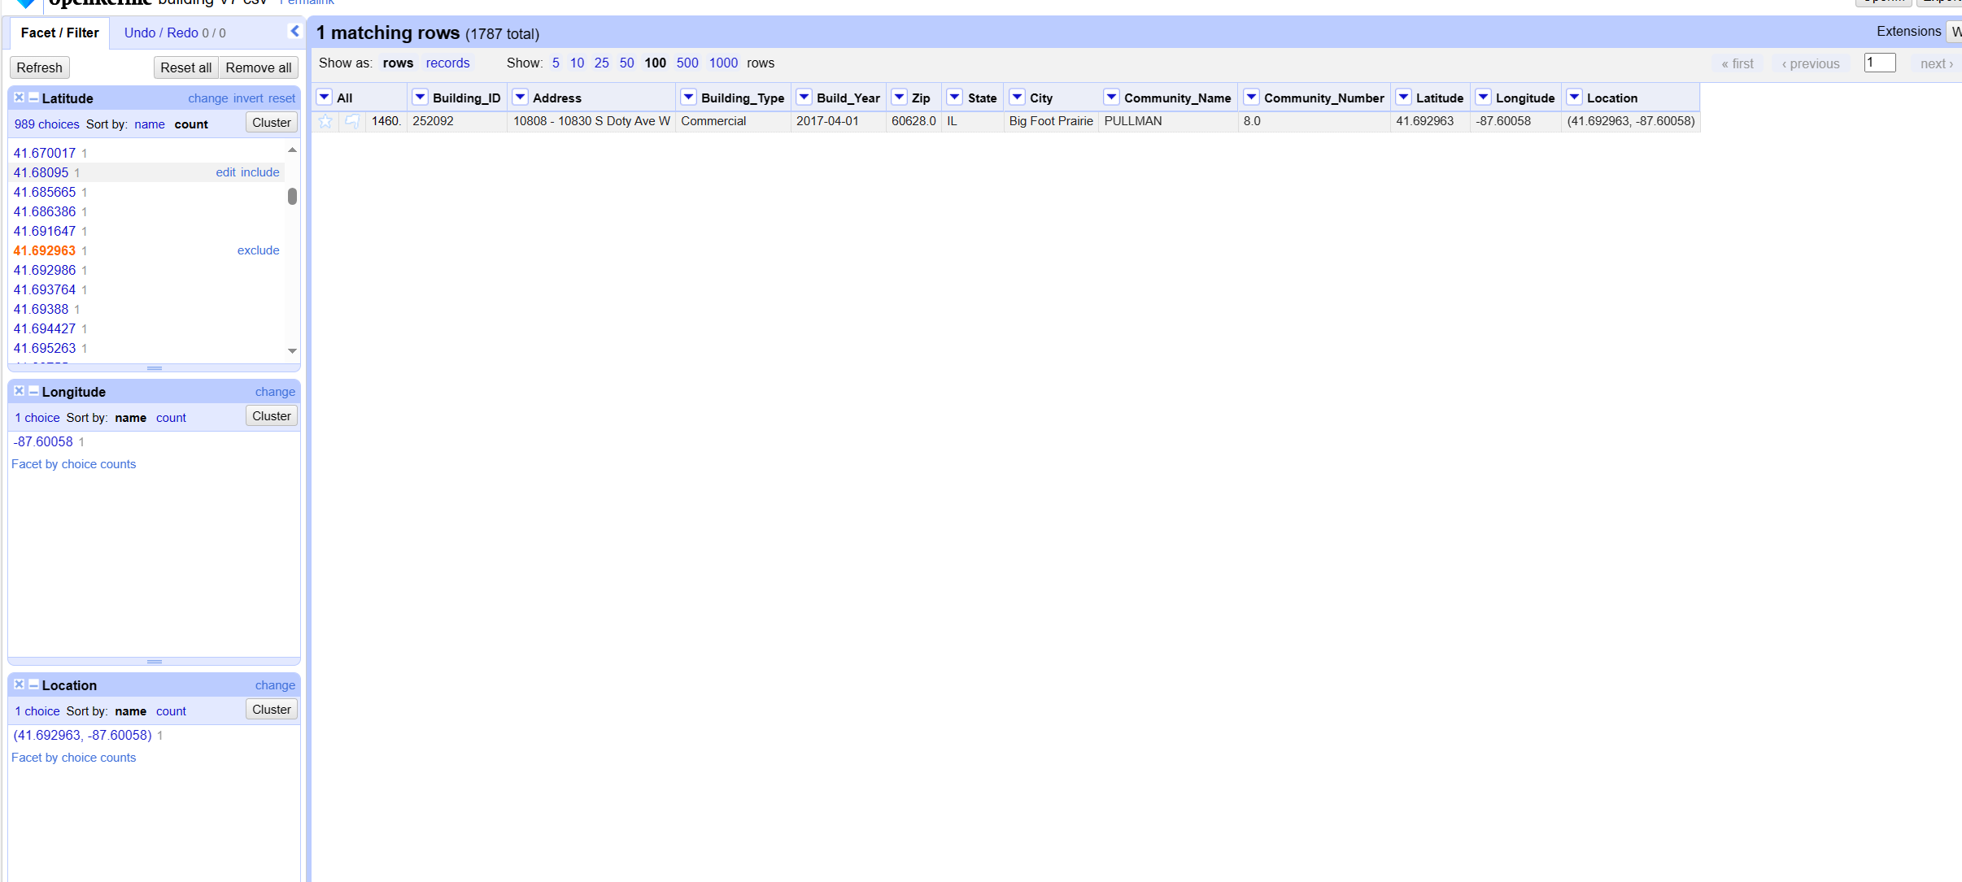
Data cleaning
Detect column value distribution after fixing e4,You can see that e4 now satisfies the constraint:

Slide 39
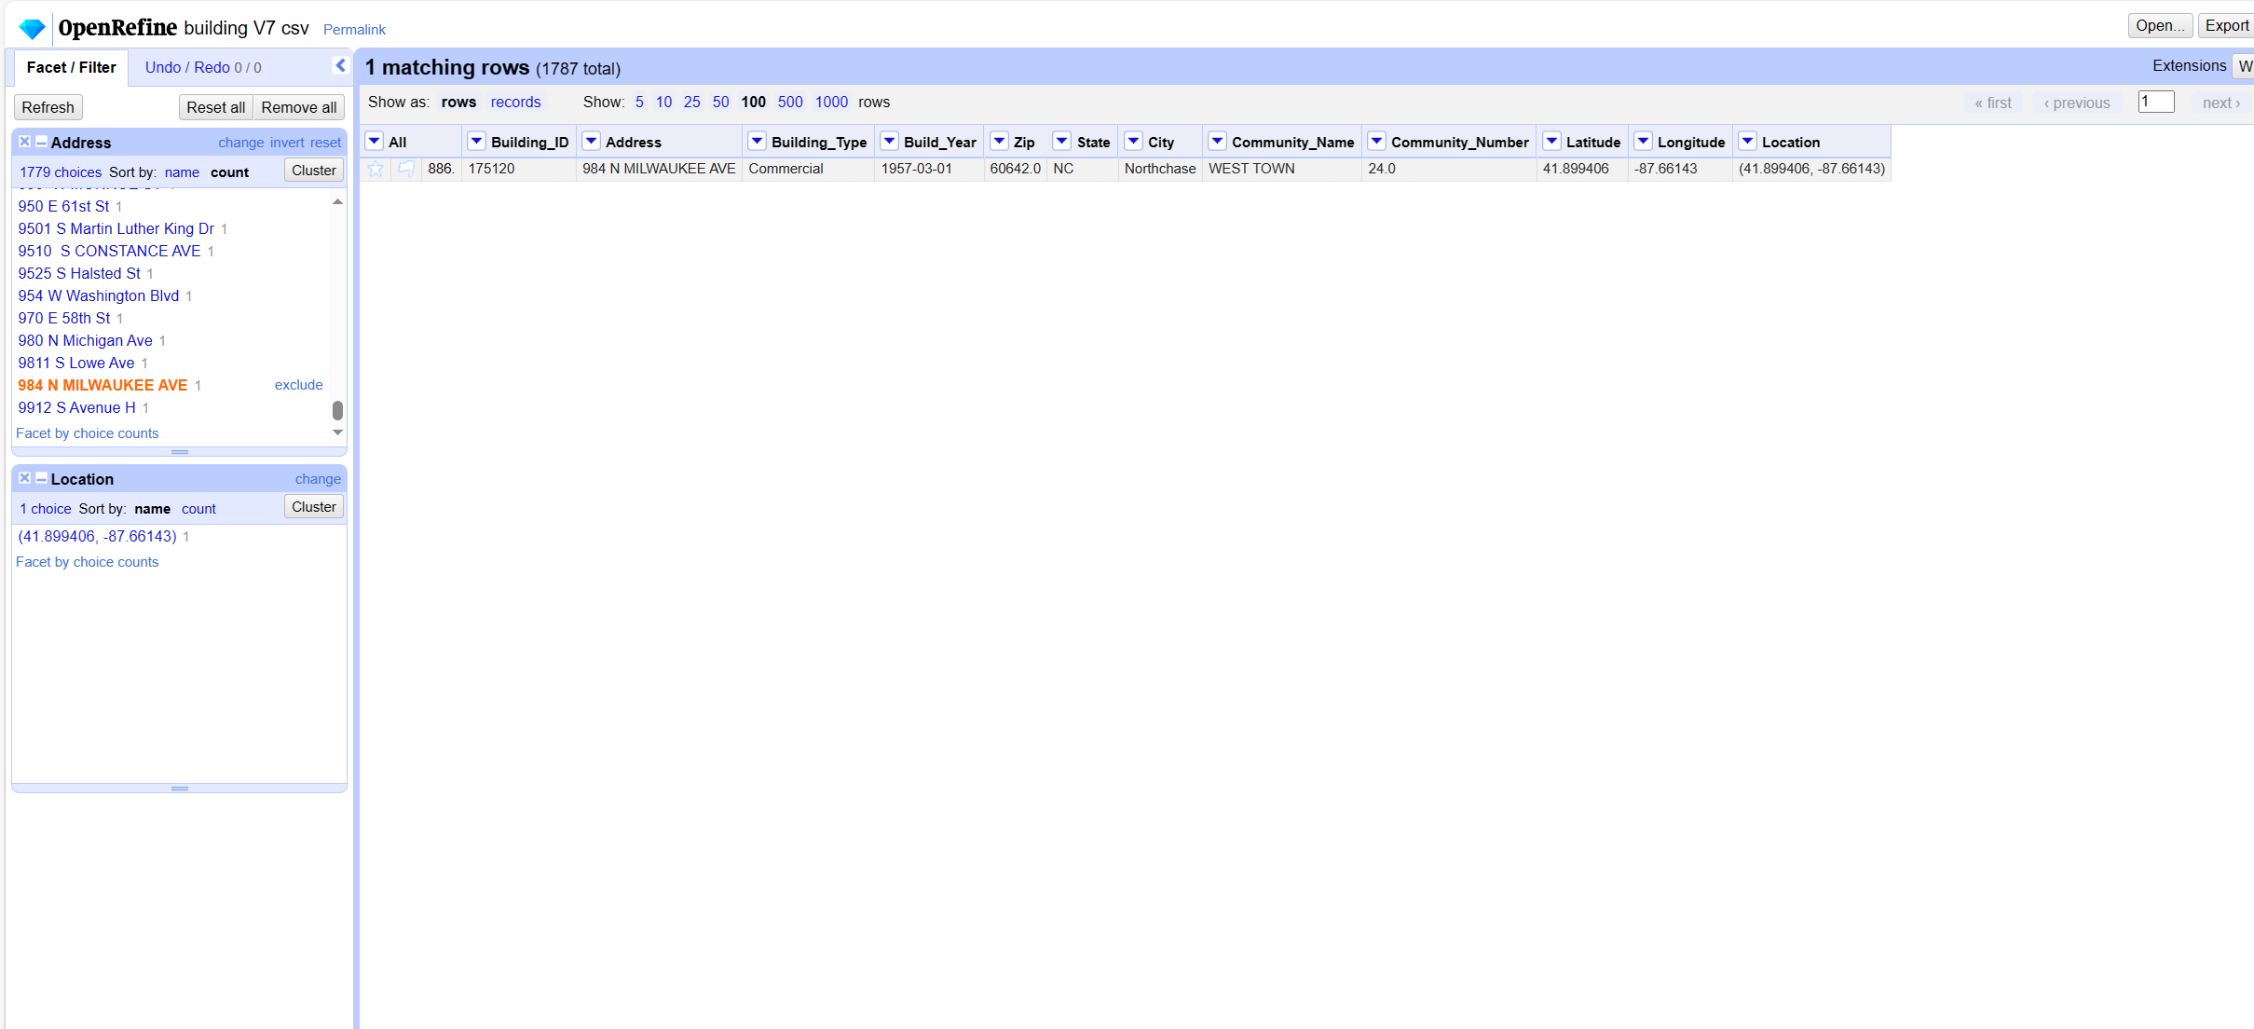
Data cleaning
Start to fix e3, first view e3 constraints column value distribution, you can see that the existing data is to meet the e3 constraints, the use of Python code also did not detect a violation of the constraints e3 situation.

Slide 40
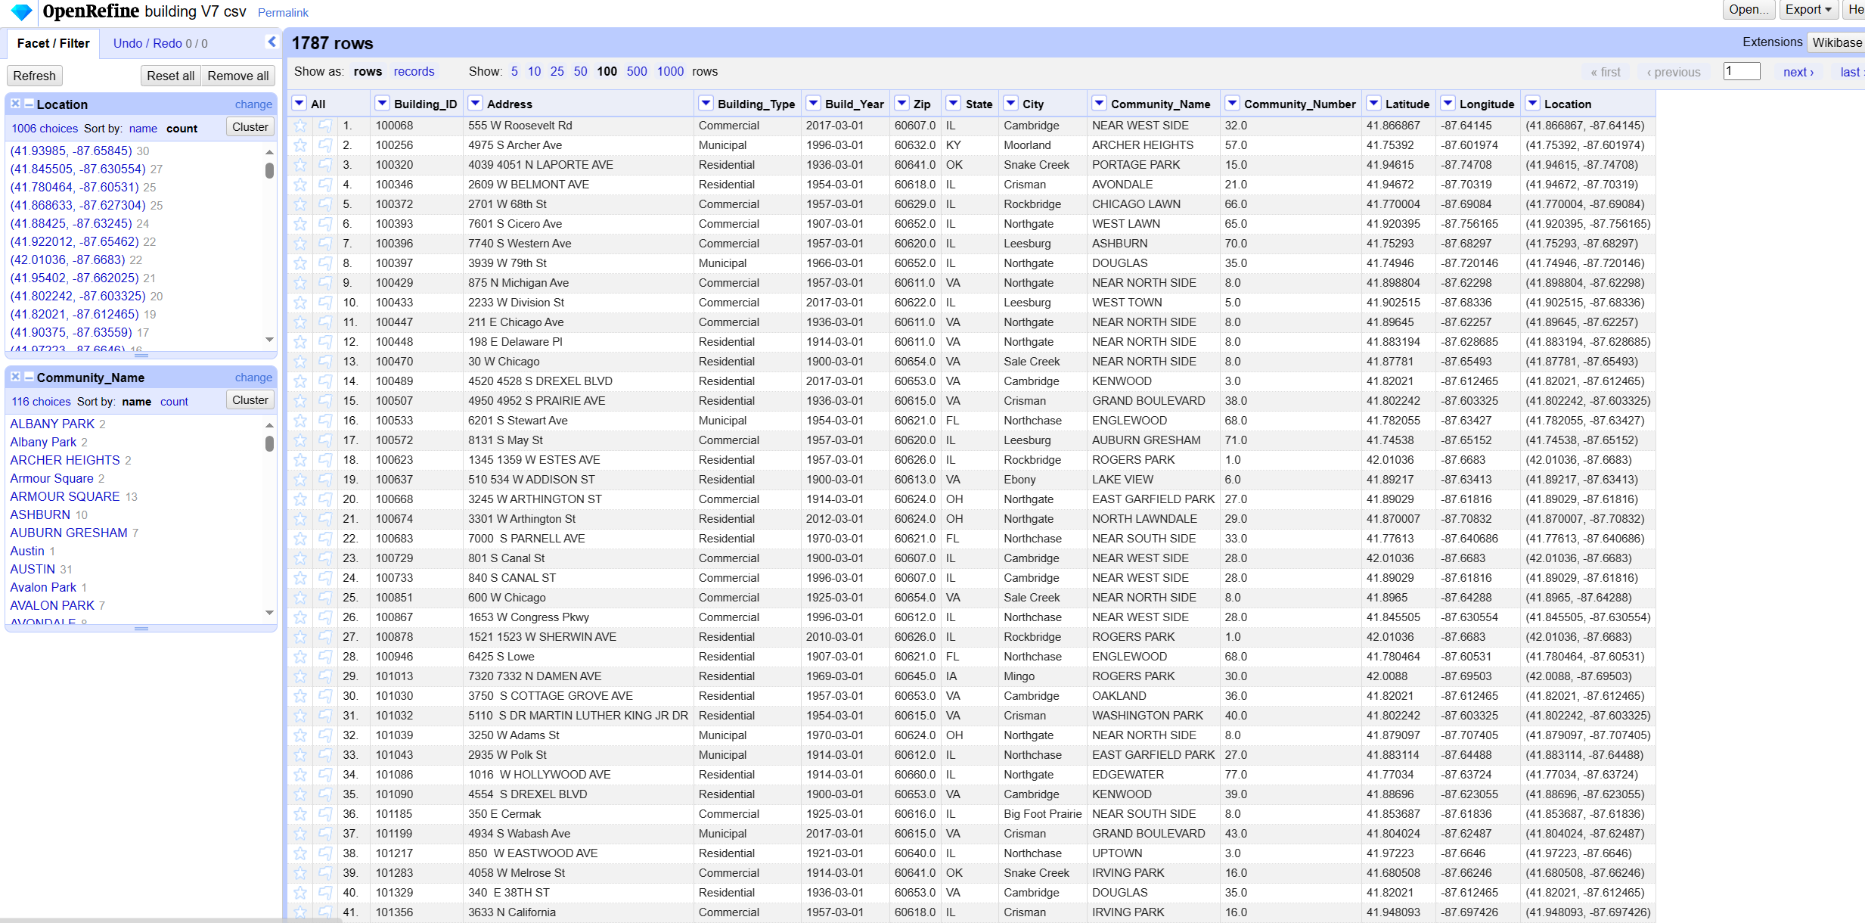
Data cleaning
Start fixing e5 to see the distribution of e5 constraint column values

Slide 41
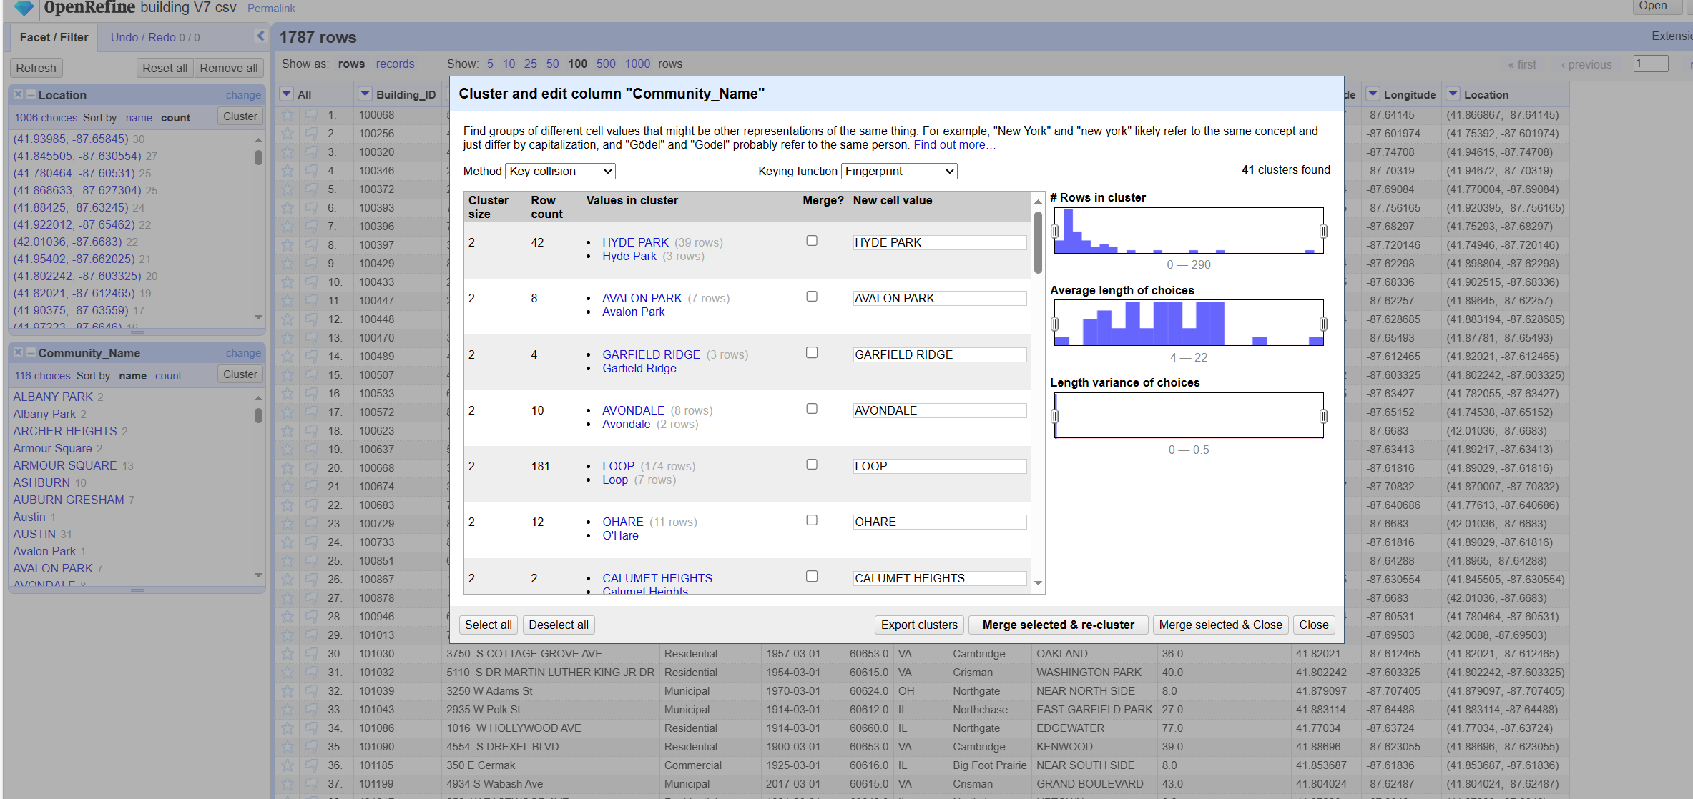
Data cleaning
Merge to fix some of the Community_Name column data using the openRefine clustering algorithm.

Slide 42
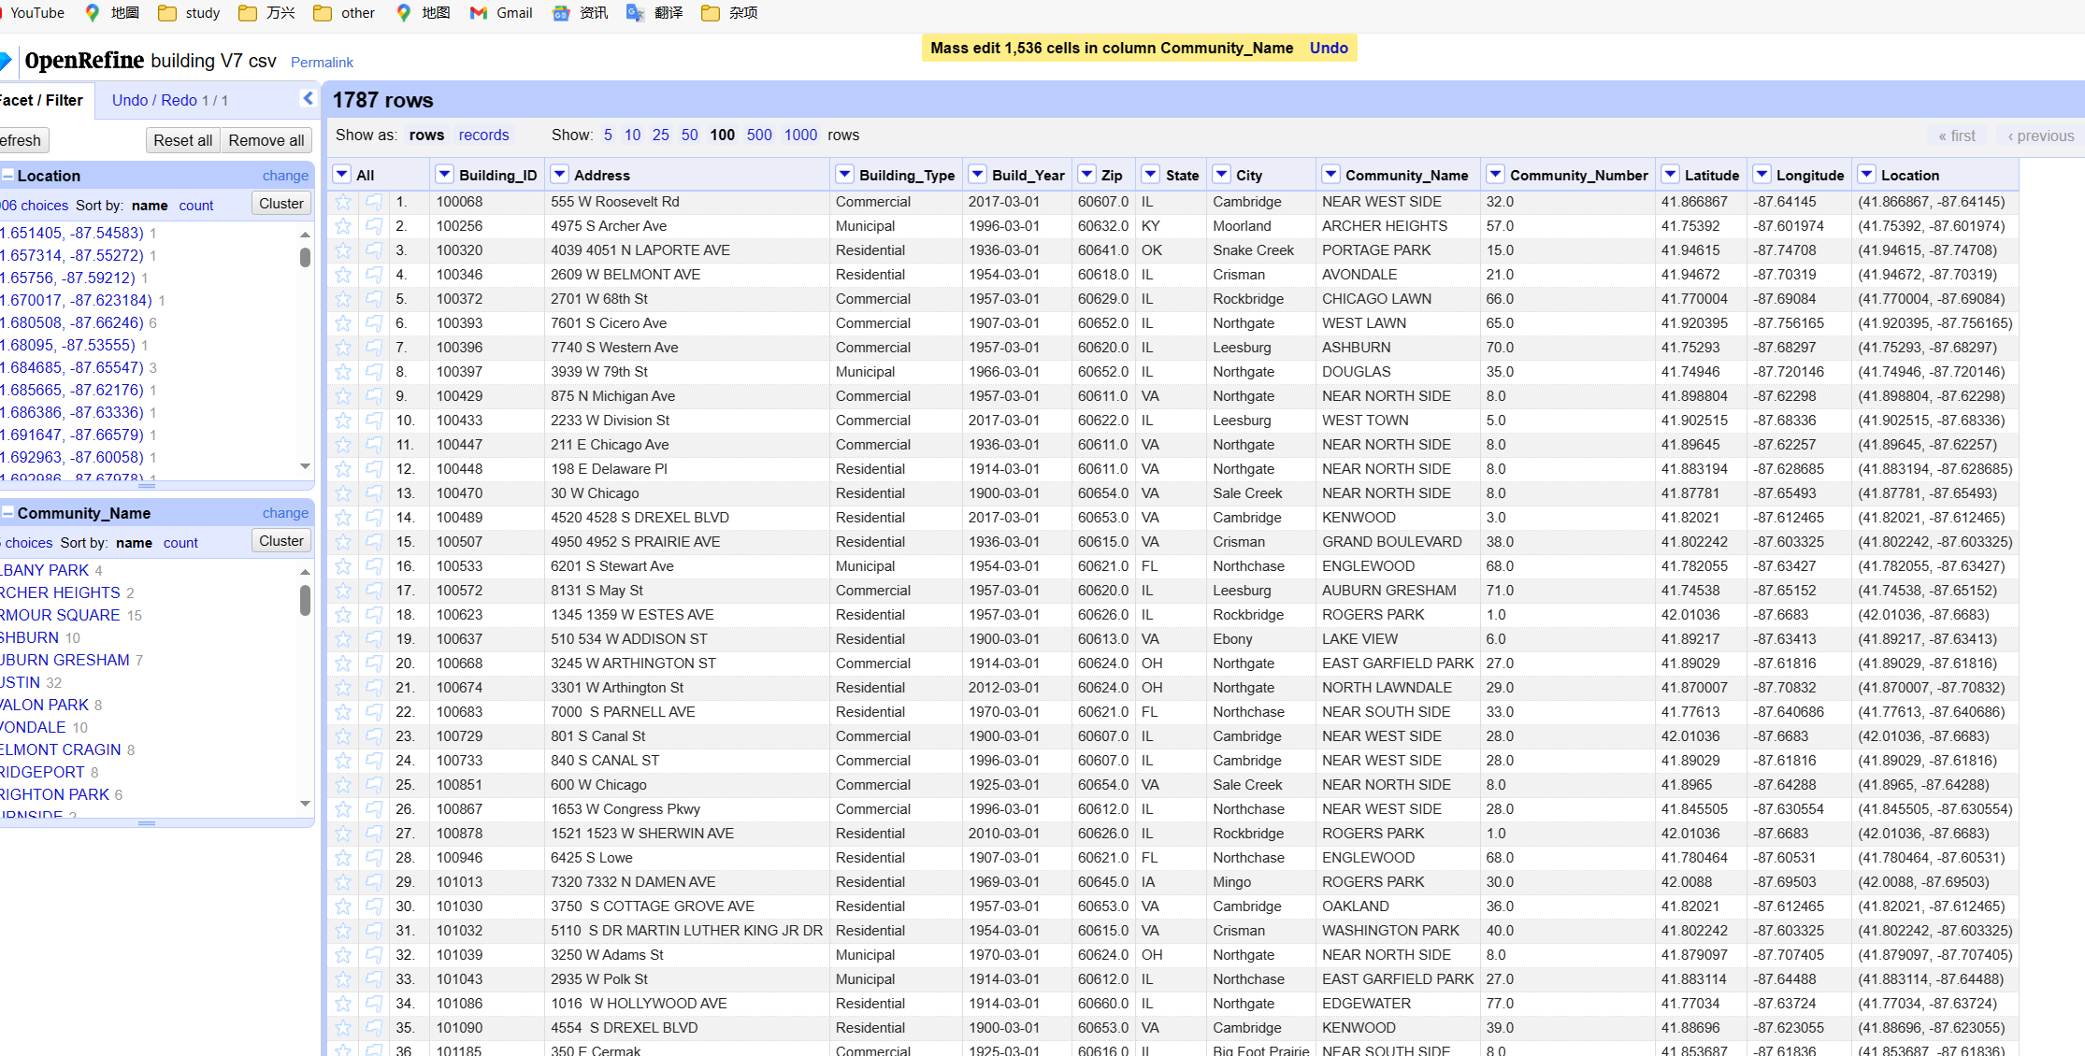
Data cleaning
Clustering algorithms merge the number of fix rows

Slide 43
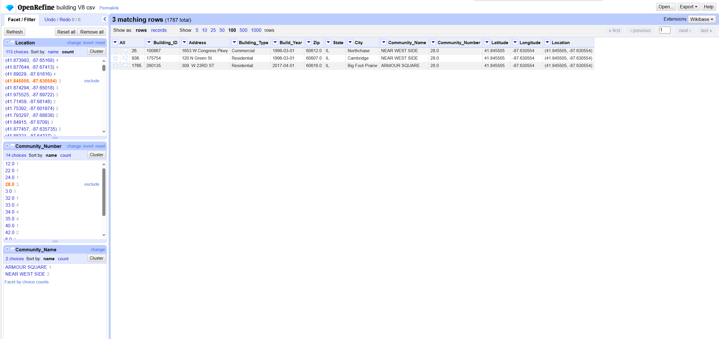
Data cleaning
After the merge, the e5 constraints are checked again, and you can see that some of them still do not satisfy the e5 constraints.

Slide 44
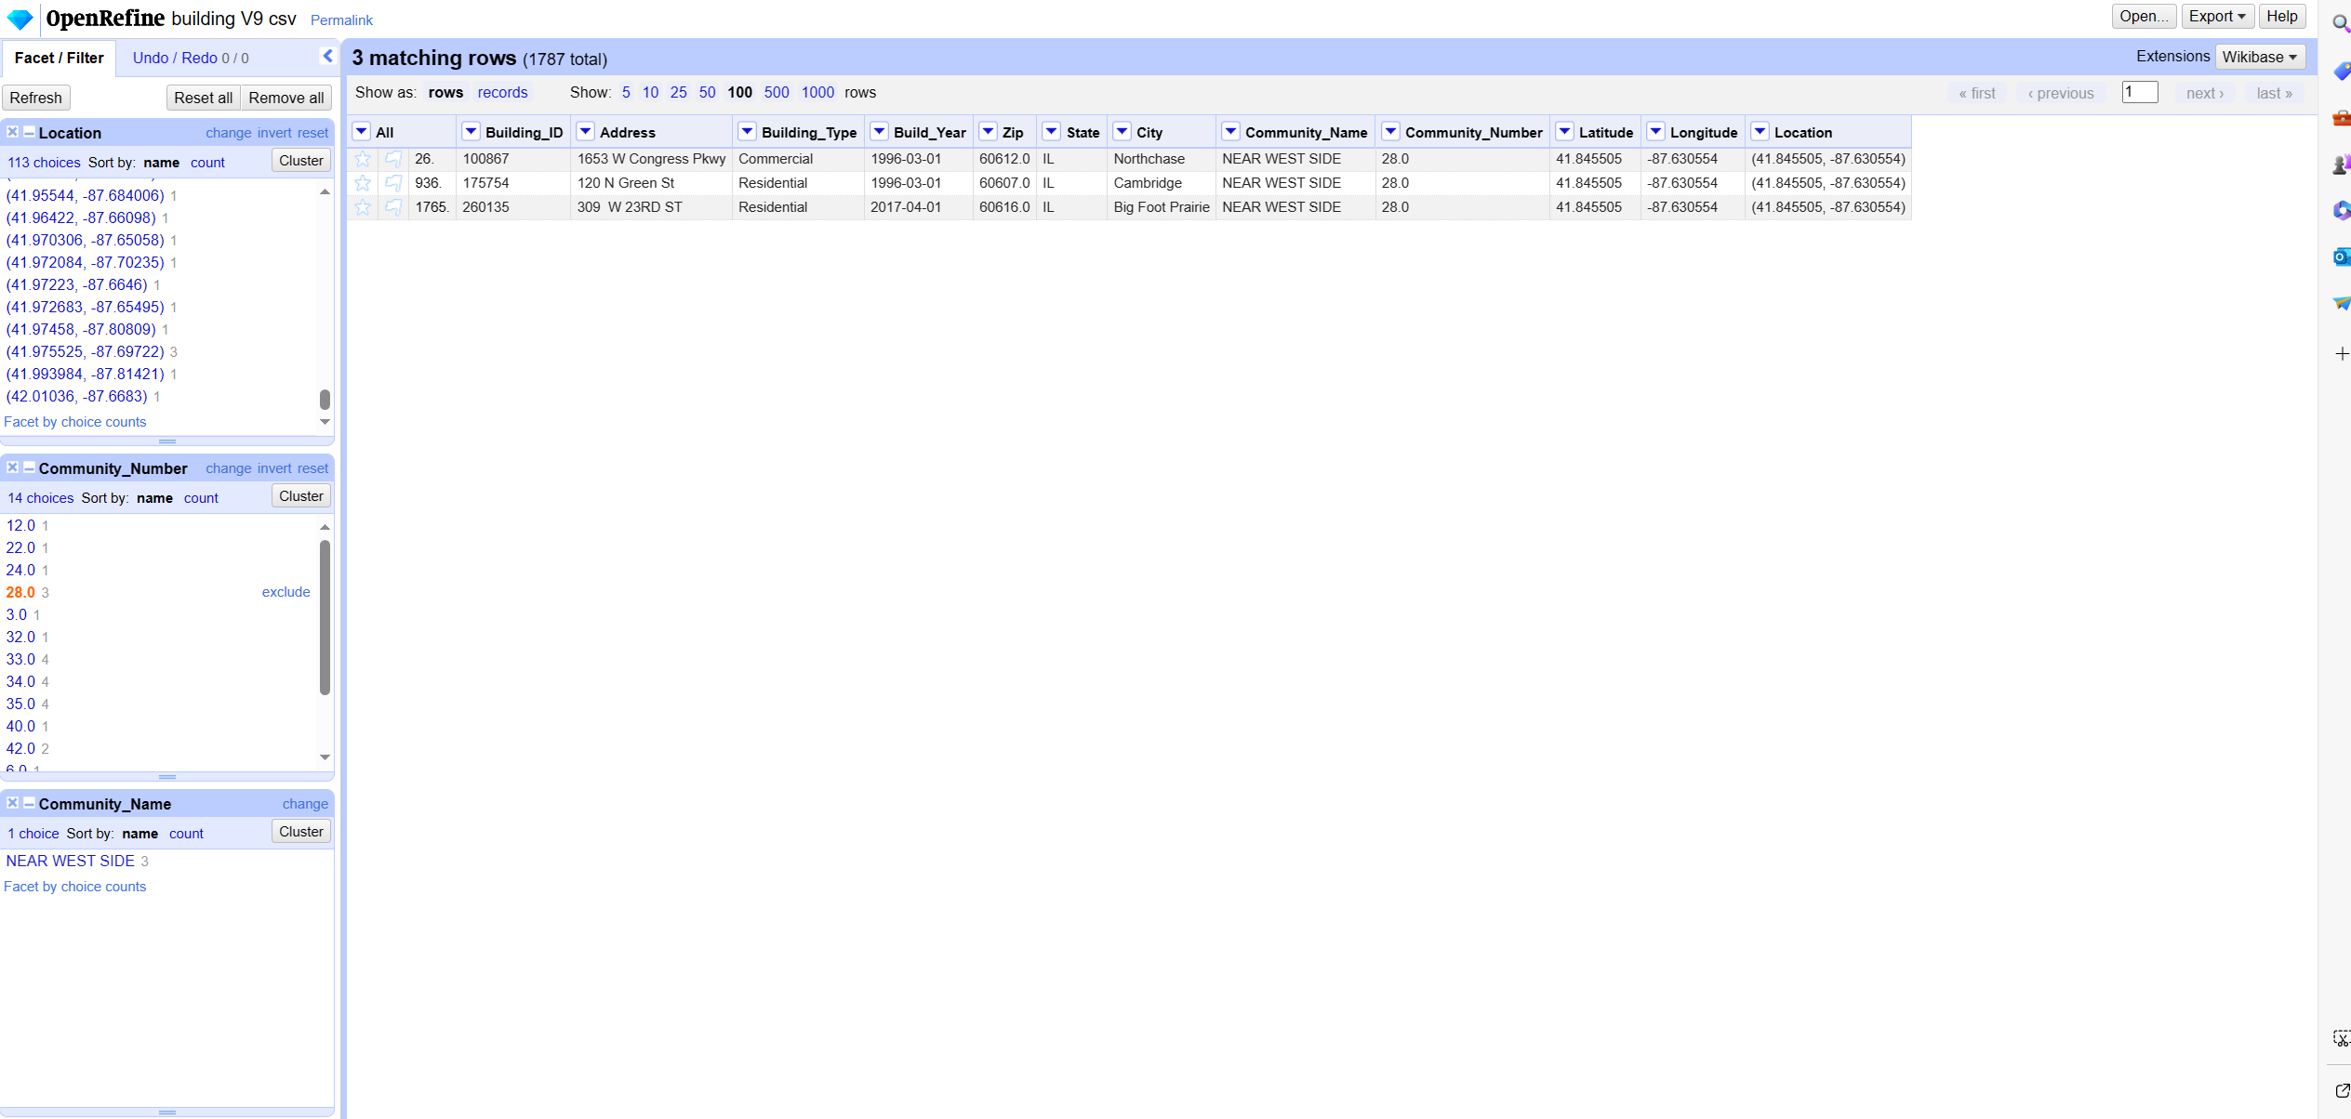
Data cleaning
Use the same fix method as e1 to fix e5, and re-import openRefine after the fiexed,You can see that the fixed data satisfy the constraint e5.

Slide 45
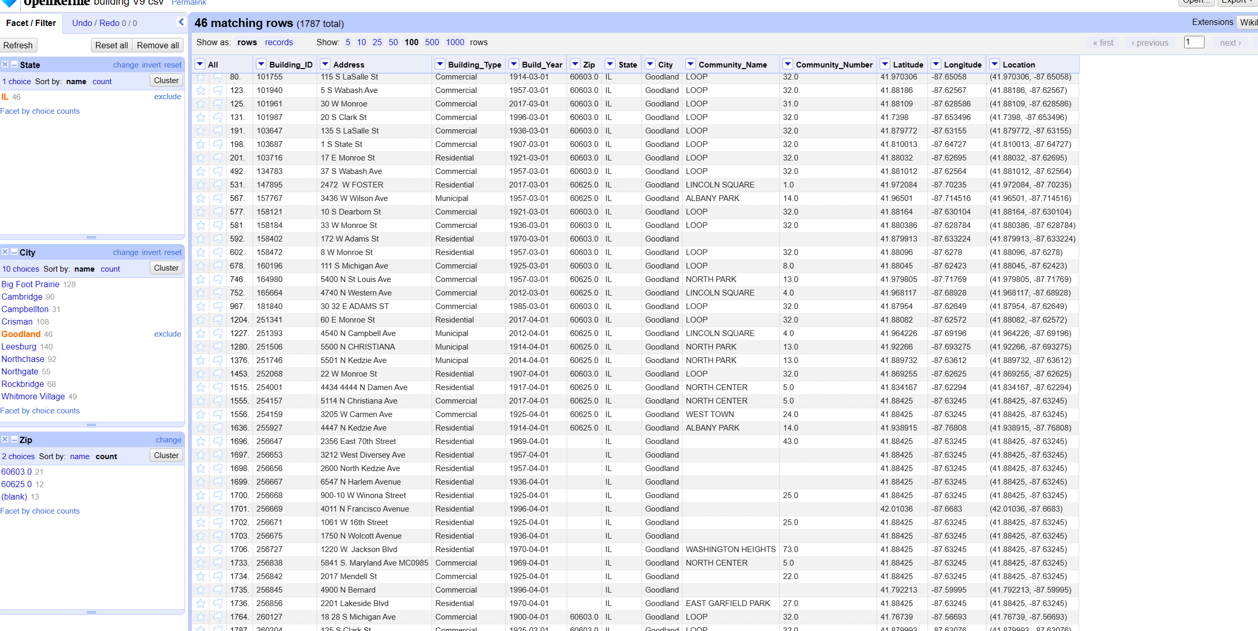
Data cleaning
Detect Zip as empty, set Zip to State, City common Zip, as setting to the most common Zip does not violate the constraints of the previous fixes.

Slide 46
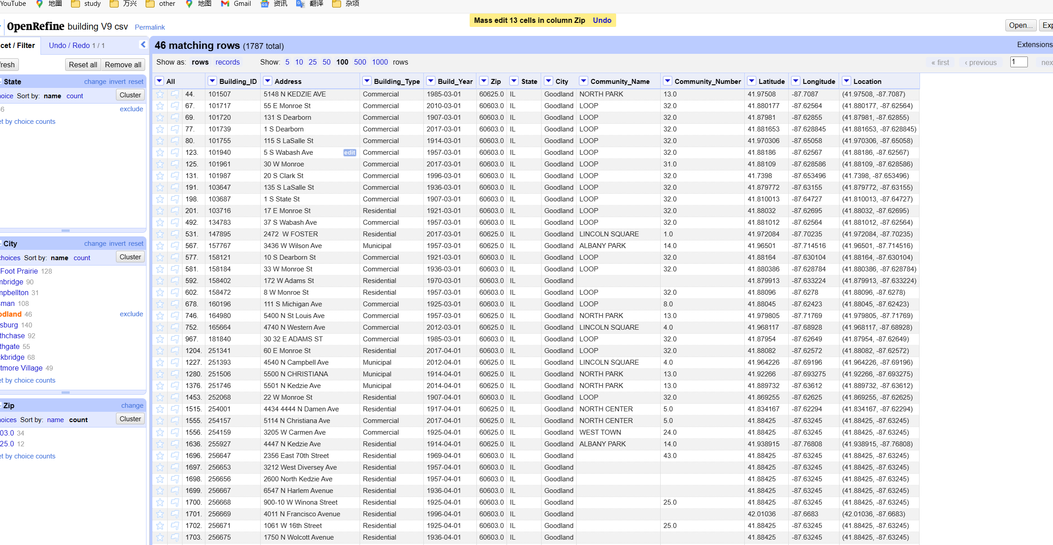
Data cleaning
Fix data after Zip column is empty

Slide 47
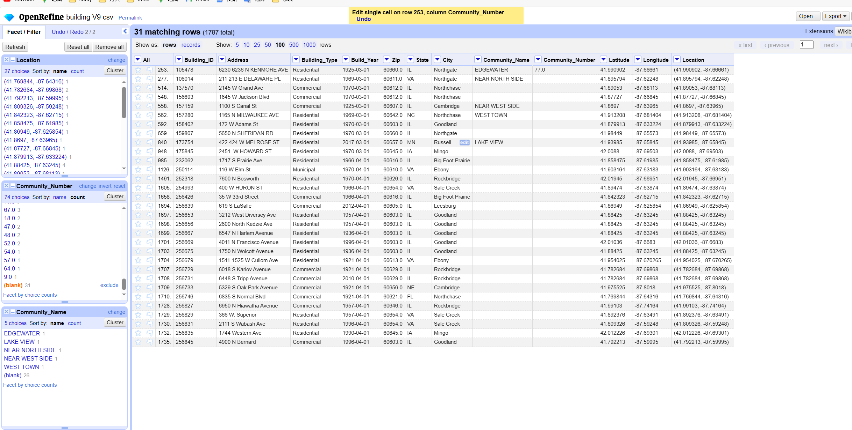
Data cleaning
Completes the case where Community_Name is not null and Community_Number is null, and Community_Number is set to a value common to Community_Name

Slide 48
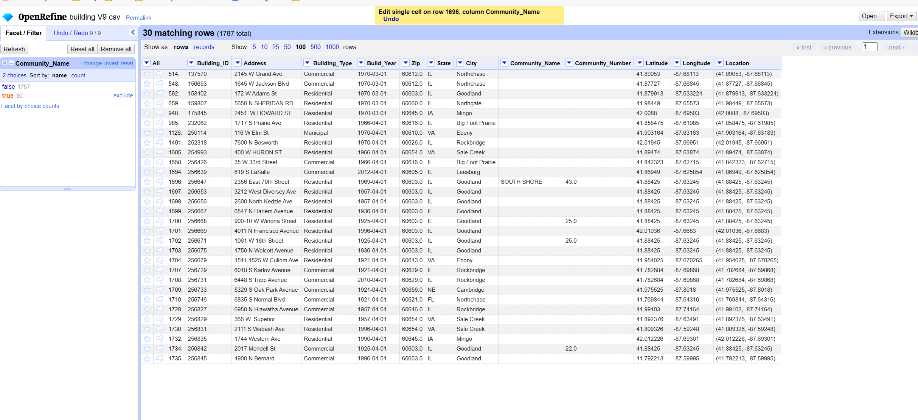
Data cleaning
Completes the case where Community_Number is not null, Community_Name is null, and Community_Name is set to a value common to Community_Name

Slide 49

Data cleaning
Because we also modified the Community_Number, Community_Name for the null case, will lead to the original repair e5 data will have a violation of the e5 situation, re-fix data.

Slide 50

Data cleaning
After fixing all the constraint data, import it into VizierDb to view it.

Slide 51

Data cleaning
Recheck e0 constraints.

Slide 52

Data cleaning
Recheck e1 constraints.

Slide 53

Data cleaning
Recheck e2 constraints.

Slide 54

Data cleaning
Recheck e3 constraints.

Slide 55

Data cleaning
Recheck e4 constraints.

Slide 56

Data cleaning
Recheck e5 constraints.

Slide 57
Data integration
Using Talend to do data integration, and extraction tasks
source table:

Slide 58

Data integration
source table:

Slide 59

Data integration
source table:

Slide 60

Data integration
source table:

Slide 61

Data integration
source table:

Slide 62

Data integration
target table:

Slide 63

Data integration
target table:

Slide 64

Data integration
target table:

Slide 65

Data integration
Create source and target files delimited.

Slide 66

Data integration
Create a schema for the corresponding table

Slide 67

Data integration
Create Data Integration Tasks.

Slide 68

Data integration
Creating schema mappings.

Slide 69

Data integration

Slide 70

Data integration

Slide 71

Data extraction
Configure the schema matching policy

Slide 72

Data extraction

Slide 73

Data extraction

Slide 74

Data extraction

Slide 75

Data extraction
Running the acquisition task, you can see the exact amount of quantities to be acquired and the amount of data to be output.

Slide 76

Data extraction
Toggles the matching method:

Slide 77

Data extraction
Changes in the amount of data after switching the matching method:

Slide 78

Data cleaning
the resulting csv file:

Slide 79
Thanks！

